Slide 1


YEAR 1
Addition & Subtraction
Add by counting on
Number bonds to 20
Block 1 – Week 1

Slide 2
Lesson 2
Step: Add by counting on (2)

Slide 3
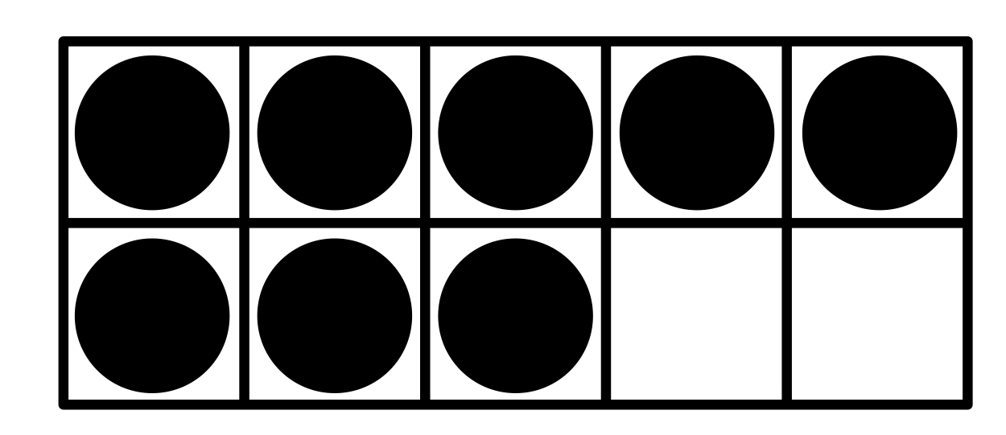
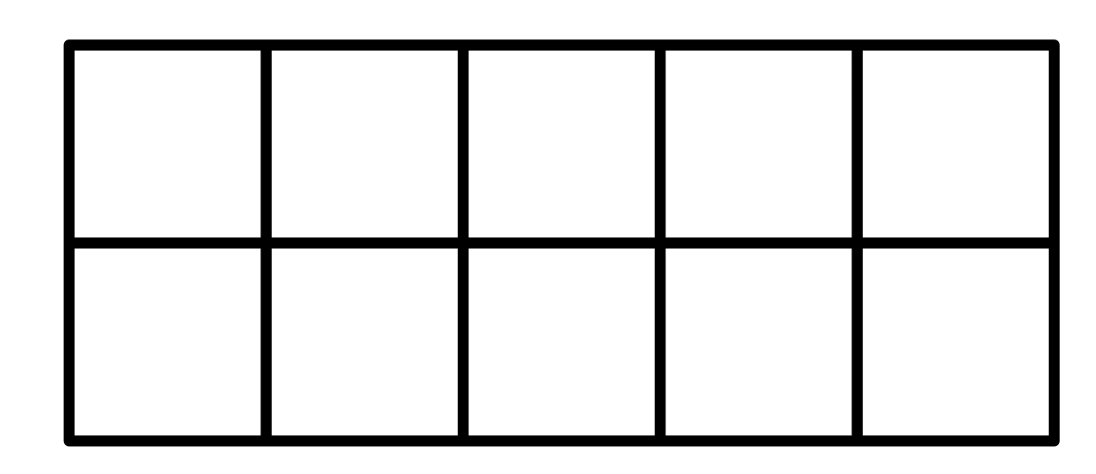
Fluency
First
Then
Now
8
First there were _____.
Then _____ more were added.
Now there is _____.
7
15

Slide 4
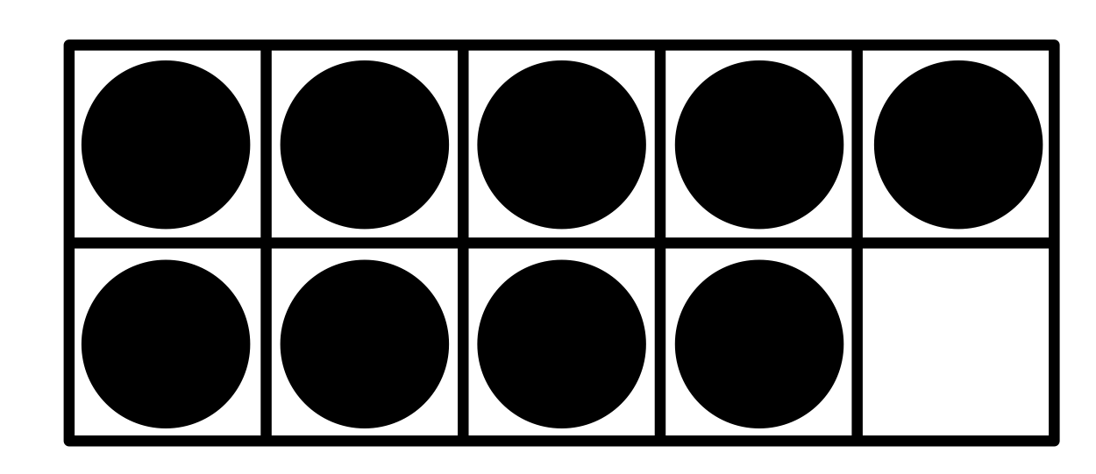
Fluency
First
Then
Now
9
First there were _____.
Then _____ more were added.
Now there is _____.
4
13

Slide 5
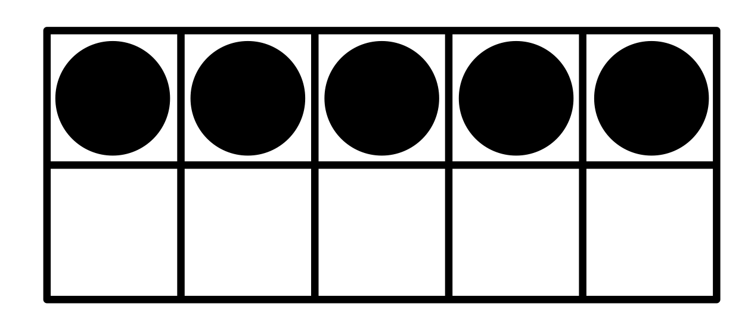
Fluency
First
Then
Now
5
First there were _____.
Then _____ more were added.
Now there is _____.
12
17

Slide 6
Fluency
How many more to make 10?
0 | 1 | 2 | 3 | 4 | 5 | 6 | 7 | 8 | 9 | 10
6
4
______ + ______ = 10

Slide 7
Fluency
How many more to make 10?
0 | 1 | 2 | 3 | 4 | 5 | 6 | 7 | 8 | 9 | 10
3
7
______ + ______ = 10

Slide 8
Fluency
How many more to make 20?
0
1
2
3
4
5
6
7
8
9
10
11
12
13
14
15
16
17
18
19
20
14
6
______ + ______ = 20

Slide 9
Fluency
How many more to make 20?
0
1
2
3
4
5
6
7
8
9
10
11
12
13
14
15
16
17
18
19
20
9
11
______ + ______ = 20

Slide 10
Fluency
How many more to make 20?
0
1
2
3
4
5
6
7
8
9
10
11
12
13
14
15
16
17
18
19
20
3
17
______ + ______ = 20

Slide 11
Spot and explain the mistake.
Reasoning
6 + 8 = 14
0
1
2
3
4
5
6
7
8
9
10
11
12
13
14
15
16
17
18
19
20
The jumps on the number line show 8 + 6.
It should show 6 plus 8 more.

