Slide 1



LIFE/work balance
We have started a #LIFEworkbalance campaign and we need your help to complete our LIFE/work balance survey.
We hope to publish the results soon, so please give 15 minutes of your time to help us get a true picture of school life.
Want to be a part of this campaign? Take the survey on our website and share it with your colleagues!
© Classroom Secrets Limited 2020

Slide 2
Year 4 – Spring Block 3 – Fractions – Add 2 or More Fractions
About This Resource:
This PowerPoint has been designed to support your teaching of this small step. It includes a starter activity and an example of each question from the Varied Fluency and Reasoning and Problem Solving resources also provided in this pack. You can choose to work through all examples provided or a selection of them depending on the needs of your class.
National Curriculum Objectives:
Mathematics Year 4: (4F4) Add and subtract fractions with the same denominator
More Year 4 Fractions resources.
Did you like this resource? Don’t forget to review it on our website.
© Classroom Secrets Limited 2019

Slide 3
Year 4 – Spring Block 3 – Fractions
Step 6: Add 2 or More Fractions
© Classroom Secrets Limited 2019

Slide 4
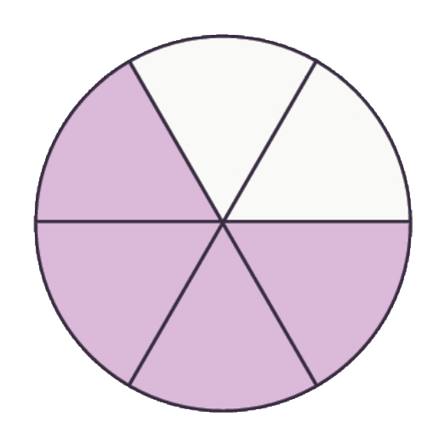
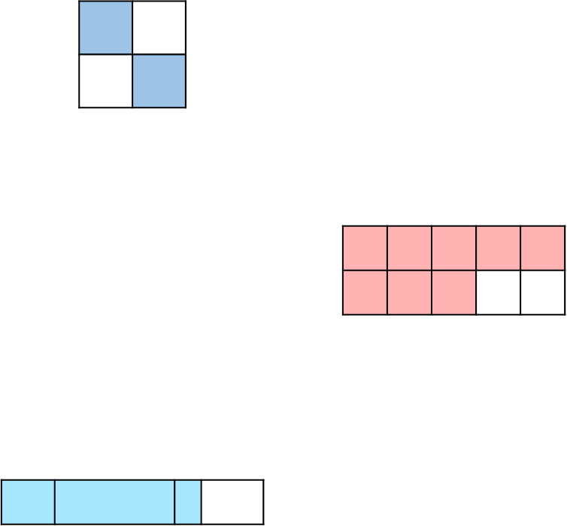

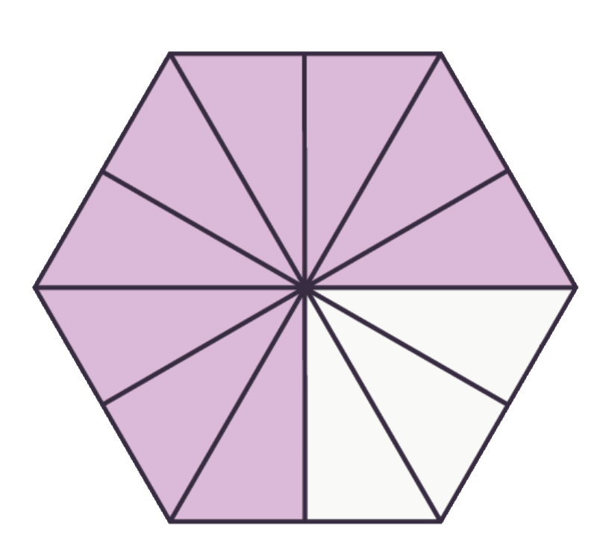

Introduction
Circle the shapes below that are equivalent to .
3
4
© Classroom Secrets Limited 2019

Slide 5
Introduction
Circle the shapes below that are equivalent to .
3
4
© Classroom Secrets Limited 2019

Slide 6
Varied Fluency 1
Shade the model to complete the following calculation.
4 | + | 9 | =
10 |  | 10
© Classroom Secrets Limited 2019

Slide 7
Varied Fluency 1
Shade the model to complete the following calculation.
4 | + | 9 | = | 13
10 |  | 10 |  | 10
© Classroom Secrets Limited 2019

Slide 8
Varied Fluency 2
Complete the calculation below.
7 | + | 4 | + | 5 | =
9 |  | 9 |  | 9
© Classroom Secrets Limited 2019

Slide 9
Varied Fluency 2
Complete the calculation below.
7 | + | 4 | + | 5 | = | 16
9 |  | 9 |  | 9 |  | 9
© Classroom Secrets Limited 2019

Slide 10
Varied Fluency 3
Tick the correct answer. Use the empty number line to help you.
5 | + | 11 | + | 4 | =
7 |  | 7 |  | 7
20
21
18
7
20
7
© Classroom Secrets Limited 2019

Slide 11
Varied Fluency 3
Tick the correct answer. Use the empty number line to help you.
5 | + | 11 | + | 4 | = | 20
7 |  | 7 |  | 7 |  | 7
✓
20
21
18
7
20
7
© Classroom Secrets Limited 2019

Slide 12
Varied Fluency 4
Fill in the missing numbers.
A. |  | 7 | + | 9 | = |  | + | 5 | =
 |  |  |  | 12 |  | 12 |  | 12 |  | 12
B. |  | 11 | + | 12 | = |  | + | 5 | =
 |  | 8 |  |  |  | 8 |  | 8
© Classroom Secrets Limited 2019

Slide 13
Varied Fluency 4
Fill in the missing numbers.
A. |  | 7 | + | 9 | = | 11 | + | 5 | = | 16
 |  | 12 |  | 12 |  | 12 |  | 12 |  | 12
B. |  | 11 | + | 12 | = | 18 | + | 5 | = | 23
 |  | 8 |  | 8 |  | 8 |  | 8 |  | 8
© Classroom Secrets Limited 2019

Slide 14
Problem Solving 1
Use the digit cards to complete the calculations below so that both equal .
27
6
A. |  | 7 | + | 9 | +
 |  | 6 |  | 6
B. |  |  | + |  | +
 |  | 6 |  | 6 |  | 6
11
9
14
6
4
© Classroom Secrets Limited 2019

Slide 15
Problem Solving 1
Use the digit cards to complete the calculations below so that both equal .
27
6
A. |  | 7 | + | 9 | + | 11
 |  | 6 |  | 6 |  | 6
B. |  | 14 | + | 4 | + | 9
 |  | 6 |  | 6 |  | 6
© Classroom Secrets Limited 2019

Slide 16
Problem Solving 2
Using at least two of the fraction cards, create two addition calculations to equal the target fraction.
14
15
15
15
29
15
11
15
4
15
© Classroom Secrets Limited 2019

Slide 17
Problem Solving 2
Using at least two of the fraction cards, create two addition calculations to equal the target fraction.
and
14
15
15
15
29
15
11
15
4
15
14 | + | 11 | + | 4
15 |  | 15 |  | 15
14 | + | 15
15 |  | 15
© Classroom Secrets Limited 2019

Slide 18


Reasoning 1
Alice and Sean are finding missing numbers in a calculation.
Who is correct? Explain how you know.
2 | + |  | + |  | = | 13
9 |  | 9 |  | 9 |  | 9
9
9
1
9
and are missing.
Alice
6
9
5
9
and are missing.
Sean
© Classroom Secrets Limited 2019

Slide 19
Reasoning 1
Alice and Sean are finding missing numbers in a calculation.
Who is correct? Explain how you know.
Sean is correct because…
2 | + |  | + |  | = | 13
9 |  | 9 |  | 9 |  | 9
9
9
1
9
and are missing.
Alice
6
9
5
9
and are missing.
Sean
© Classroom Secrets Limited 2019

Slide 20
Reasoning 1
Alice and Sean are finding missing numbers in a calculation.
Who is correct? Explain how you know.
Sean is correct because Alice’s numbers only add up to .
2 | + | 6 | + | 5 | = | 13
9 |  | 9 |  | 9 |  | 9
9
9
1
9
and are missing.
Alice
6
9
5
9
and are missing.
Sean
12
9
© Classroom Secrets Limited 2019

