Slide 1
LIFE/work balance
We have started a #LIFEworkbalance campaign and we need your help to complete our LIFE/work balance survey.
We hope to publish the results soon, so please give 15 minutes of your time to help us get a true picture of school life.
Want to be a part of this campaign? Take the survey on our website and share it with your colleagues!
© Classroom Secrets Limited 2019

Slide 2
Year 4 – Spring Block 1 – Multiplication and Division – Multiply 3 Numbers
About This Resource:
This PowerPoint has been designed to support your teaching of this small step. It includes a starter activity and an example of each question from the Varied Fluency and Reasoning and Problem Solving resources also provided in this pack. You can choose to work through all examples provided or a selection of them depending on the needs of your class.
National Curriculum Objectives:
Mathematics Year 4: (4C6a) Recall multiplication and division facts for multiplication tables up to 12 × 12
Mathematics Year 4: (4C6b) Use place value, known and derived facts to multiply and divide mentally, including: multiplying by 0 and 1; dividing by 1; multiplying together three numbers
More Year 4 Multiplication and Division resources.
Did you like this resource? Don’t forget to review it on our website.
© Classroom Secrets Limited 2018

Slide 3
Year 4 – Spring Block 1 – Multiplication and Division
Step 2: Multiply 3 Numbers
© Classroom Secrets Limited 2018

Slide 4
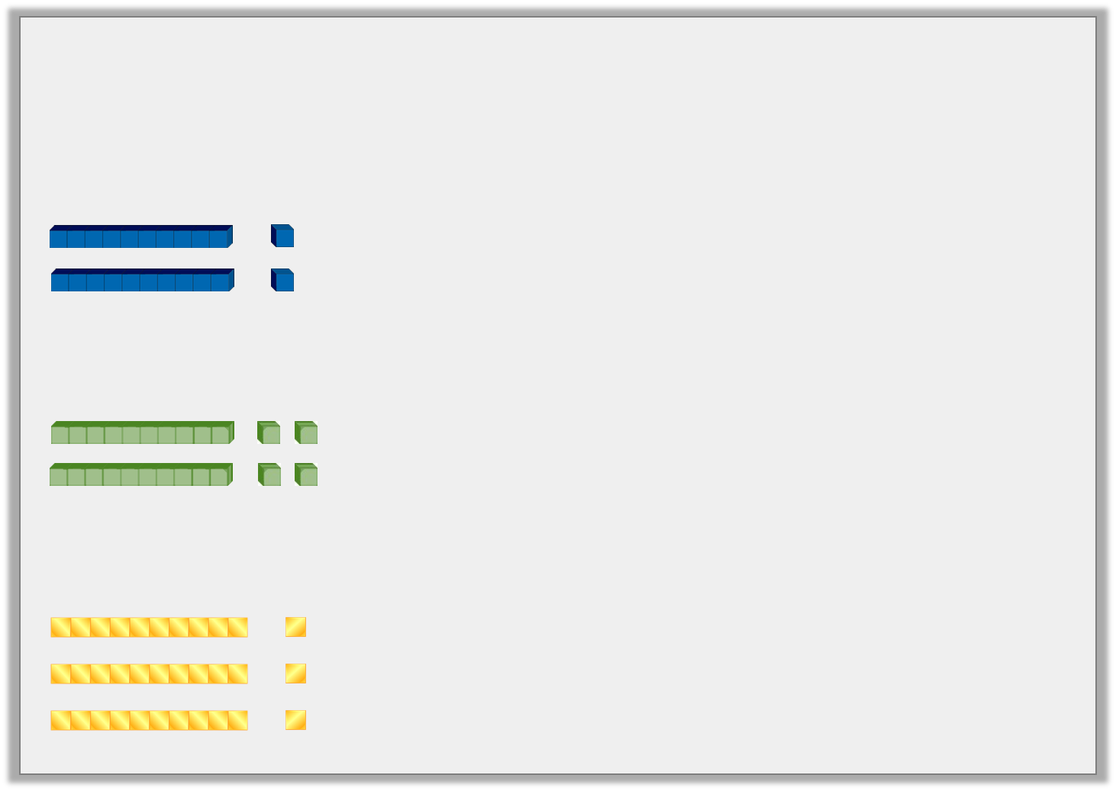
Introduction
Match the picture to the correct sentence.
3 lots of 10 + 3 lots of 1 is the same as 3 lots of 11
2 lots of 10 + 2 lots of 2 is the same as 2 lots of 12
2 lots of 10 + 2 lots of 1 is the same as 2 lots of 11
© Classroom Secrets Limited 2018

Slide 5
Introduction
Match the picture to the correct sentence.
3 lots of 10 + 3 lots of 1 is the same as 3 lots of 11
2 lots of 10 + 2 lots of 2 is the same as 2 lots of 12
2 lots of 10 + 2 lots of 1 is the same as 2 lots of 11
© Classroom Secrets Limited 2018

Slide 6
Varied Fluency 1
Complete the calculations below.
9 | x | 5 | x | 2 | =
3 | x | 8 | x | 3 | =
© Classroom Secrets Limited 2018

Slide 7
Varied Fluency 1
Complete the calculations below.
9 | x | 5 | x | 2 | = | 90
3 | x | 8 | x | 3 | = | 72
© Classroom Secrets Limited 2018

Slide 8
Varied Fluency 2
True or false?
6 | x | 9 | x | 2 | = | 99
© Classroom Secrets Limited 2018

Slide 9
Varied Fluency 2
True or false?
False; 6 x 9 x 2 = 108
6 | x | 9 | x | 2 | = | 99
© Classroom Secrets Limited 2018

Slide 10
Varied Fluency 3
Complete the calculation. Write three different multiplication calculations using all of the numbers below.
7 | x | 3 | x | 6 | =
© Classroom Secrets Limited 2018

Slide 11
Varied Fluency 3
Complete the calculation. Write three different multiplication calculations using all of the numbers below.
Various answers, for example:
3 x 7 x 6; 6 x 7 x 3; 6 x 3 x 7
7 | x | 3 | x | 6 | = | 126
© Classroom Secrets Limited 2018

Slide 12
Varied Fluency 4
Tick the calculation that is correct.
A. |  | 5 | x | 3 | x | 6 | = | 80
B. |  | 7 | x | 5 | x | 4 | = | 140
C. |  | 4 | x | 8 | x | 4 | = | 120
© Classroom Secrets Limited 2018

Slide 13
Varied Fluency 4
Tick the calculation that is correct.
A. |  | 5 | x | 3 | x | 6 | = | 80
B. |  | 7 | x | 5 | x | 4 | = | 140 |  | 
C. |  | 4 | x | 8 | x | 4 | = | 120
© Classroom Secrets Limited 2018

Slide 14
Reasoning 1
Tick the best way to group the numbers in the calculation below.
Explain your choice.
7 | x | 4 | x | 3
3 | x | 4 | x | 7
© Classroom Secrets Limited 2018

Slide 15
Reasoning 1
Tick the best way to group the numbers in the calculation below.
Explain your choice.
3 x 4 x 7 is the best way to group the numbers because…
7 | x | 4 | x | 3
3 | x | 4 | x | 7 |  | 
© Classroom Secrets Limited 2018

Slide 16
Reasoning 1
Tick the best way to group the numbers in the calculation below.
Explain your choice.
3 x 4 x 7 is the best way to group the numbers because you can use the times tables to work out 3 x 4 = 12 then 12 x 7 = 84. If you start with 7 x 4 = 28, it is harder to work out 28 x 3.
7 | x | 4 | x | 3
3 | x | 4 | x | 7 |  | 
© Classroom Secrets Limited 2018

Slide 17
Problem Solving 1
Arrange the cards to create a multiplication number sentence.
Which cards cannot be used?
5
7
9
x
2
x
6
=
84
96
© Classroom Secrets Limited 2018

Slide 18
Problem Solving 1
Arrange the cards to create a multiplication number sentence.
Various answers, for example:
6 x 2 x 7 = 84
Which cards cannot be used? 5, 9 and 96 cannot be used.
5
7
9
x
2
x
6
=
84
96
© Classroom Secrets Limited 2018

Slide 19
Problem Solving 2
Using the numbers from 2 to 9, complete the number sentence below.
You may use each number more than once.
Find 5 possibilities.
 | x |  | x |  | = | 72
© Classroom Secrets Limited 2018

Slide 20
Problem Solving 2
Using the numbers from 2 to 9, complete the number sentence below.
You may use each number more than once.
Find 5 possibilities.
Various answers, for example:
6 x 3 x 4; 3 x 6 x 4; 8 x 3 x 3; 3 x 8 x 3
6 | x | 4 | x | 3 | = | 72
© Classroom Secrets Limited 2018

