Slide 1



LIFE/work balance
We have started a #LIFEworkbalance campaign and we need your help to complete our LIFE/work balance survey.
We hope to publish the results soon, so please give 15 minutes of your time to help us get a true picture of school life.
Want to be a part of this campaign? Take the survey on our website and share it with your colleagues!
© Classroom Secrets Limited 2019

Slide 2
Year 2 – Spring Block 1 – Multiplication and Division – Make Equal Groups – Grouping
About This Resource:
This PowerPoint has been designed to support your teaching of this small step. It includes a starter activity and an example of each question from the Varied Fluency and Reasoning and Problem Solving resources also provided in this pack. You can choose to work through all examples provided or a selection of them depending on the needs of your class.
National Curriculum Objectives:
Mathematics Year 2: (2C6) Recall and use multiplication and division facts for the 2, 5 and 10 multiplication tables, including recognising odd and even numbers
Mathematics Year 2: (2C7) Calculate mathematical statements for multiplication and division within the multiplication tables and write them using the multiplication (×), division (÷) and equals (=) signs
Mathematics Year 2: (2C8) Solve problems involving multiplication and division, using materials, arrays, repeated addition, mental methods, and multiplication and division facts, including problems in contexts
Mathematics Year 2: (2C9b) Show that multiplication of two numbers can be done in any order (commutative) and division of one number by another cannot
More Year 2 Multiplication and Division resources.
Did you like this resource? Don’t forget to review it on our website.
© Classroom Secrets Limited 2018

Slide 3
Year 2 – Spring Block 1 – Multiplication and Division
Step 2: Make Equal Groups – Grouping
© Classroom Secrets Limited 2018

Slide 4

Introduction
Sort the autumn treasure into 3 equal groups. Each group needs the same number of each type of object.
© Classroom Secrets Limited 2018

Slide 5
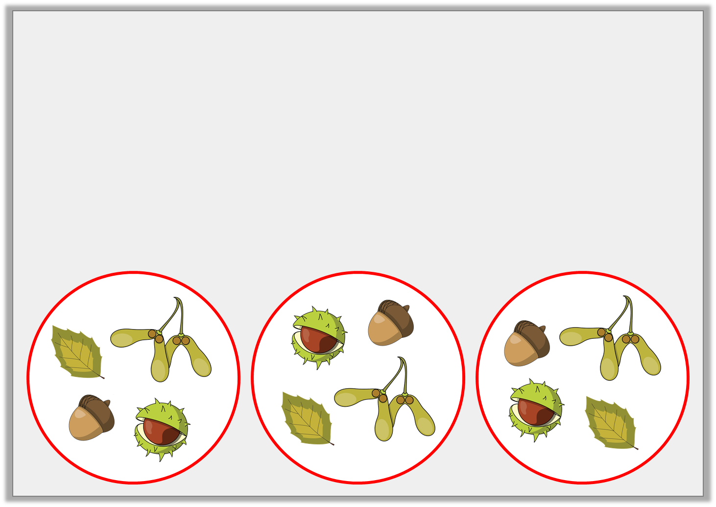
Introduction
Sort the autumn treasure into 3 equal groups. Each group needs the same number of each type of object.
© Classroom Secrets Limited 2018

Slide 6

Varied Fluency 1
Sort 27 cubes into equal groups of 3.
How many groups are there?
© Classroom Secrets Limited 2018

Slide 7

Varied Fluency 1
Sort 27 cubes into equal groups of 3.
How many groups are there?
9 groups.
© Classroom Secrets Limited 2018

Slide 8
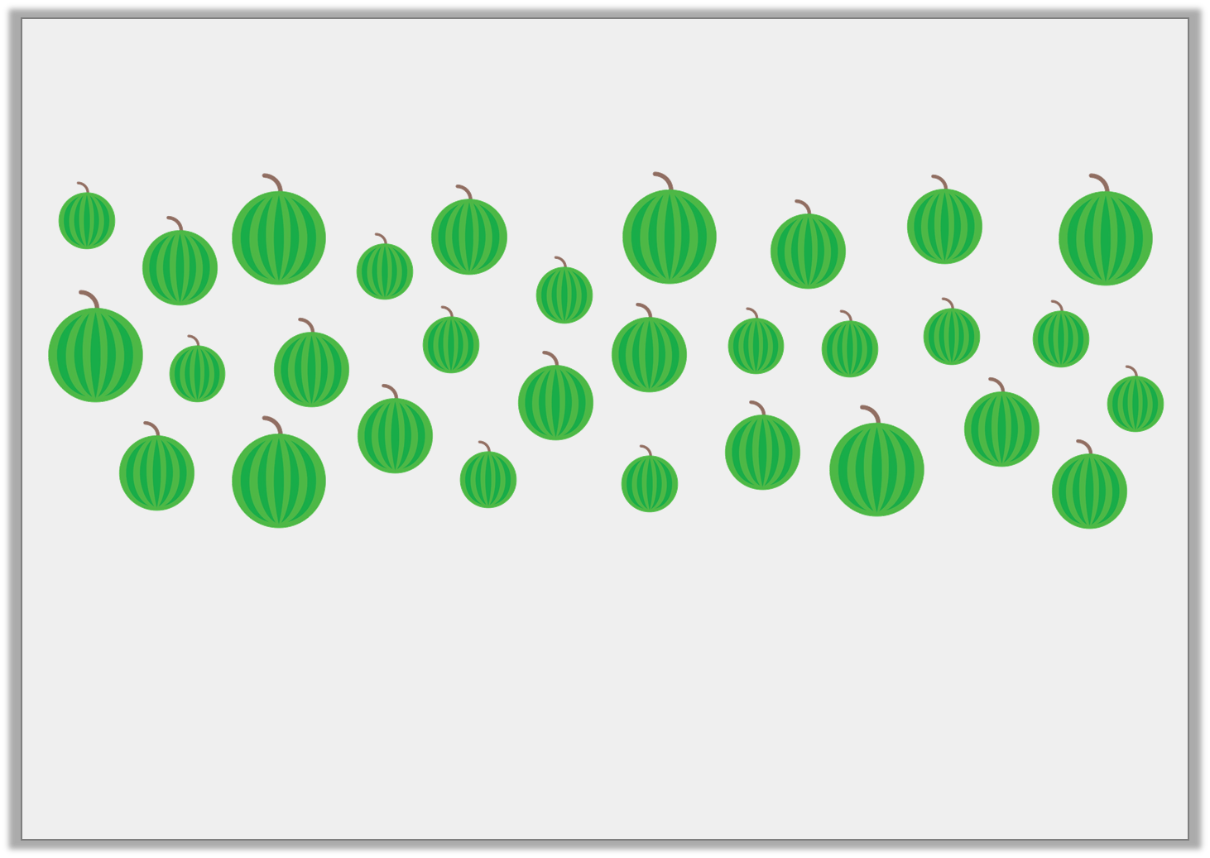
Varied Fluency 2
Put the melons into equal groups of 6.
Use the groups to complete this calculation:
30 | ÷ |  | = | 6
© Classroom Secrets Limited 2018

Slide 9
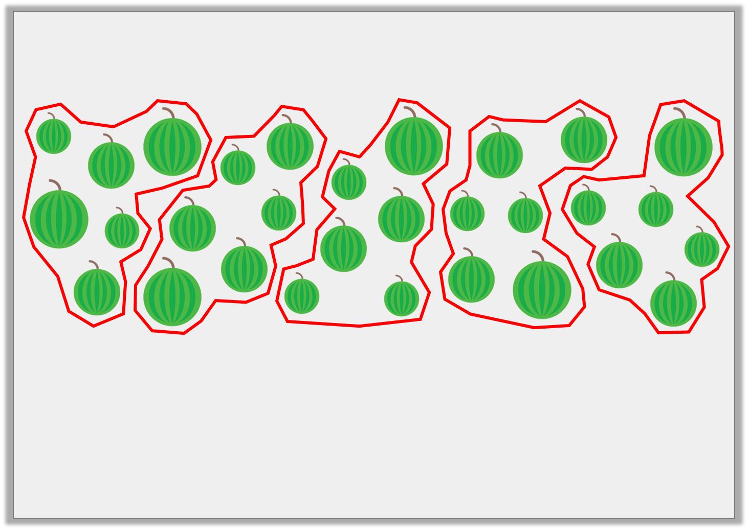
Varied Fluency 2
Put the melons into equal groups of 6.
Use the groups to complete this calculation:
30 | ÷ | 5 | = | 6
© Classroom Secrets Limited 2018

Slide 10

Varied Fluency 3
Use the bead string to help fill in the calculation.
 | ÷ |  | =
© Classroom Secrets Limited 2018

Slide 11
Varied Fluency 3
Use the bead string to help fill in the calculation.
15 | ÷ | 3 | = | 5
© Classroom Secrets Limited 2018

Slide 12
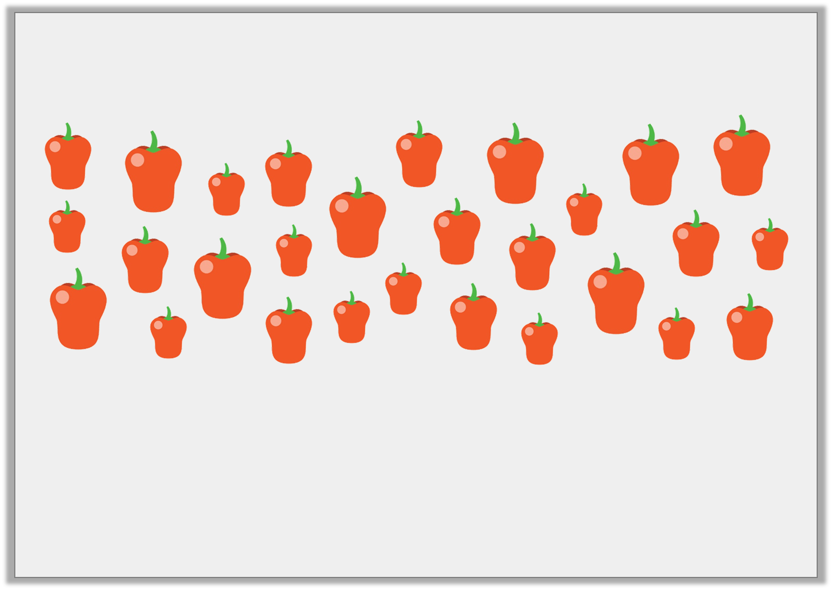
Varied Fluency 4
Miss Gupta buys 28 peppers. Each group needs 7 peppers.
How many groups can have peppers?
© Classroom Secrets Limited 2018

Slide 13
Varied Fluency 4
Miss Gupta buys 28 peppers. Each group needs 7 peppers.
How many groups can have peppers?
4 groups.
© Classroom Secrets Limited 2018

Slide 14
Problem Solving 1
Which of these numbers can be put into 4 equal groups?
What do they have in common?
16
22
24
© Classroom Secrets Limited 2018

Slide 15
Problem Solving 1
Which of these numbers can be put into 4 equal groups?
What do they have in common?
16 and 24. They are both in the 4 times table/are multiples of 4.
16
22
24
© Classroom Secrets Limited 2018

Slide 16

Problem Solving 2
These 28 jewels need to be sorted into equal groups.
Apart from 28 groups of 1, what is the largest possible number of groups?
Apart from 1 group of 28, what is the smallest possible number of groups?
© Classroom Secrets Limited 2018

Slide 17
Problem Solving 2
These 28 jewels need to be sorted into equal groups.
Apart from 28 groups of 1, what is the largest possible number of groups?
Apart from 1 group of 28, what is the smallest possible number of groups?
Largest: 14 Smallest: 2
© Classroom Secrets Limited 2018

Slide 18
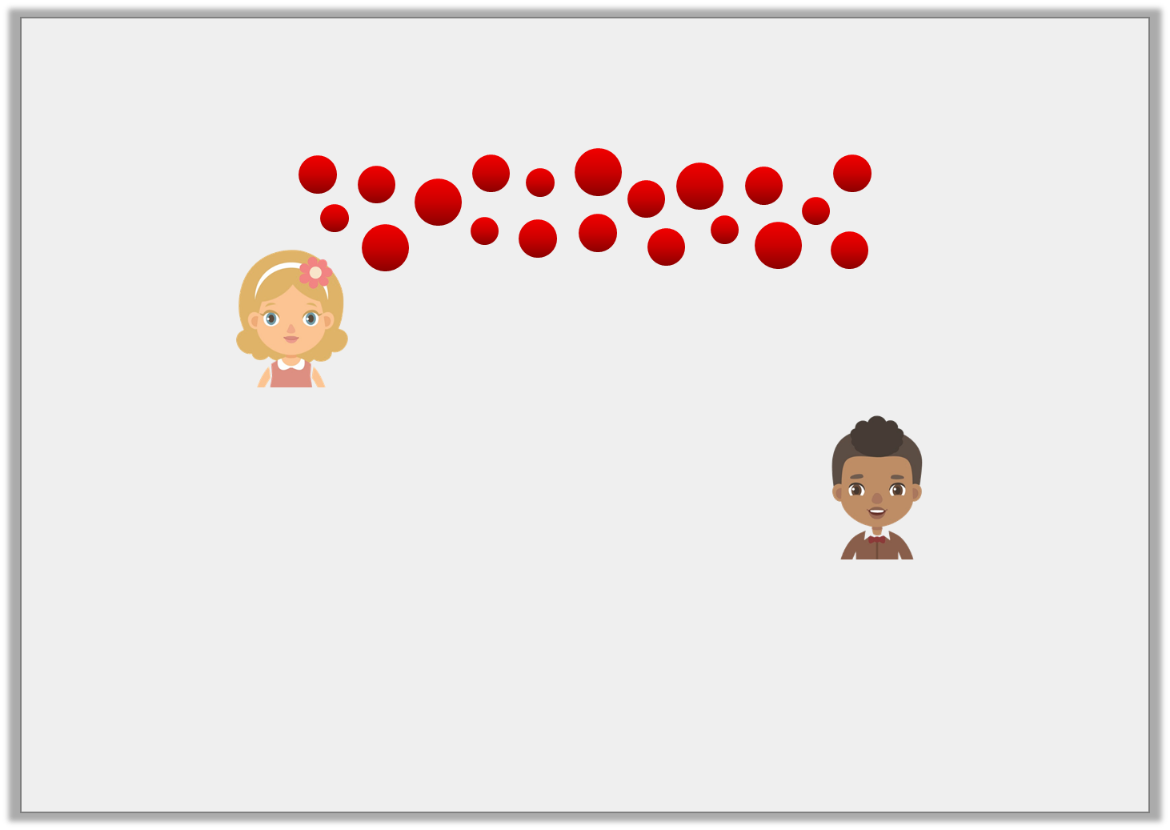
Reasoning 1
Joy and Marco have 20 counters.
Who is correct? Explain why.
20 in equal groups of 2 makes 9 groups.
Joy
20 in equal groups of 4 makes 5 groups.
Marco
© Classroom Secrets Limited 2018

Slide 19
Reasoning 1
Joy and Marco have 20 counters.
Who is correct? Explain why.
Marco is correct because…
20 in equal groups of 2 makes 9 groups.
Joy
20 in equal groups of 4 makes 5 groups.
Marco
© Classroom Secrets Limited 2018

Slide 20
Reasoning 1
Joy and Marco have 20 counters.
Who is correct? Explain why.
Marco is correct because 20 ÷ 5 = 4.
20 in equal groups of 2 makes 9 groups.
Joy
20 in equal groups of 4 makes 5 groups.
Marco
© Classroom Secrets Limited 2018

