Slide 1
LIFE/work balance
We have started a #LIFEworkbalance campaign and we need your help to complete our LIFE/work balance survey.
We hope to publish the results soon, so please give 15 minutes of your time to help us get a true picture of school life.
Want to be a part of this campaign? Take the survey on our website and share it with your colleagues!
© Classroom Secrets Limited 2019

Slide 2
Year 2 – Autumn Block 4 – Multiplication and Division – The 10 Times Table
About This Resource:
This PowerPoint has been designed to support your teaching of this small step. It includes a starter activity and an example of each question from the Varied Fluency and Reasoning and Problem Solving resources also provided in this pack. You can choose to work through all examples provided or a selection of them depending on the needs of your class.
National Curriculum Objectives:
Mathematics Year 2: (2C6) Recall and use multiplication and division facts for the 2, 5 and 10 multiplication tables, including recognising odd and even numbers
Mathematics Year 2: (2C7) Calculate mathematical statements for multiplication and division within the multiplication tables and write them using the multiplication (×), division (÷) and equals (=) signs
More Year 2 Multiplication and Division resources.
Did you like this resource? Don’t forget to review it on our website.
© Classroom Secrets Limited 2018

Slide 3
Year 2 – Autumn Block 4 – Multiplication and Division
Step 9: The 10 Times Table
© Classroom Secrets Limited 2018

Slide 4
Introduction
Circle the three mistakes.
0 | 10 | 20 | 80 | 40 | 60 | 60 | 70
13 | 23 | 33 | 40 | 53 | 63 | 73 | 83
© Classroom Secrets Limited 2018

Slide 5
Introduction
Circle the three mistakes.
0 | 10 | 20 | 80 | 40 | 60 | 60 | 70
13 | 23 | 33 | 40 | 53 | 63 | 73 | 83
© Classroom Secrets Limited 2018

Slide 6
Varied Fluency 1
True or false?
If I multiply 9 by 10 the answer will be 90.
© Classroom Secrets Limited 2018

Slide 7
Varied Fluency 1
True or false?
True.
If I multiply 9 by 10 the answer will be 90.
© Classroom Secrets Limited 2018

Slide 8
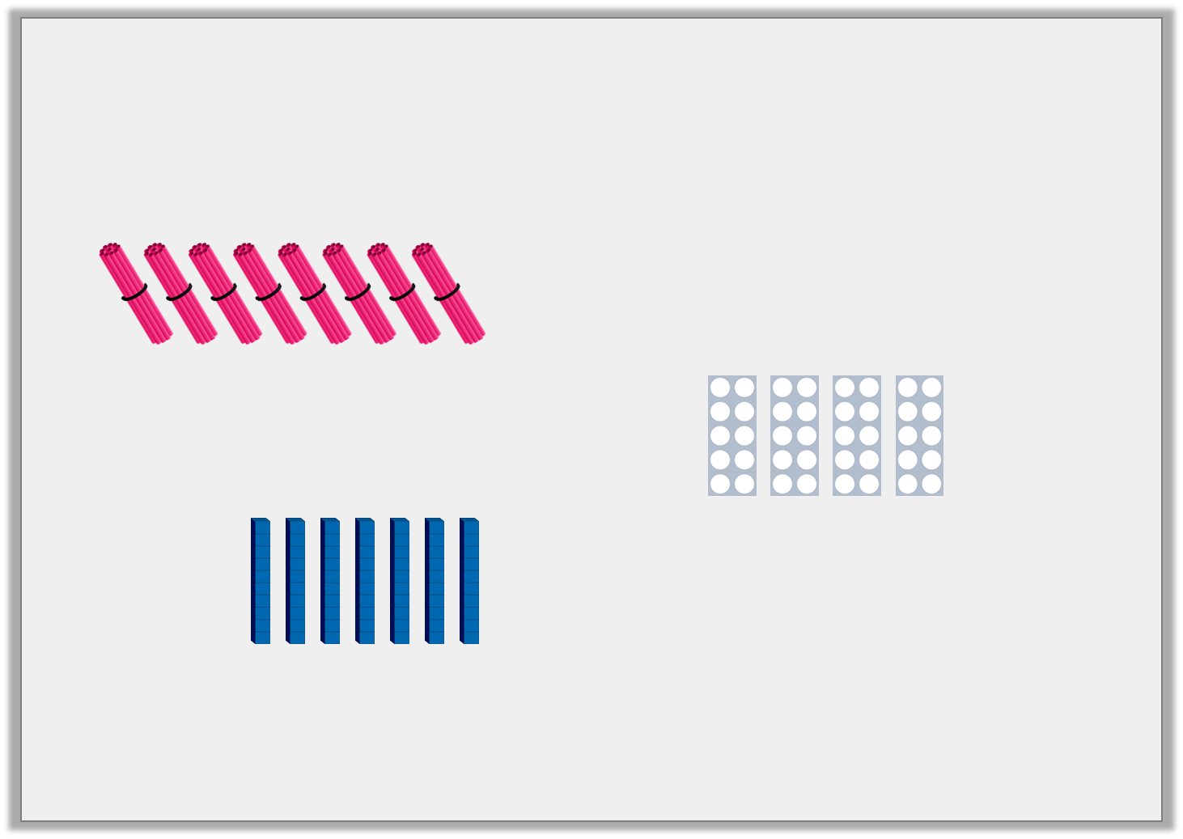
Varied Fluency 2
Use <, > or = to complete the statements below.
 |  | 2 x 10
4 x 10
 |  | 10 x 0
© Classroom Secrets Limited 2018

Slide 9
Varied Fluency 2
Use <, > or = to complete the statements below.
 | > | 2 x 10
4 x 10 | =
 | > | 10 x 0
© Classroom Secrets Limited 2018

Slide 10
Varied Fluency 3
Circle the correct calculation to match the array below.
A. | 7 x 10 |  | B. | 4 x 10 |  | C. | 5 x 10
© Classroom Secrets Limited 2018

Slide 11
Varied Fluency 3
Circle the correct calculation to match the array below.
A. | 7 x 10 |  | B. | 4 x 10 |  | C. | 5 x 10
© Classroom Secrets Limited 2018

Slide 12
Varied Fluency 4
Choose the correct numbers to complete the number sentence.
 | = |  | x | 10
4 |  | 40 |  | 14
© Classroom Secrets Limited 2018

Slide 13
Varied Fluency 4
Choose the correct numbers to complete the number sentence.
40 | = | 4 | x | 10
4 |  | 40 |  | 14
© Classroom Secrets Limited 2018

Slide 14
Problem Solving 1
Match the equations to their correct answers.
Write two multiplication equations to match the odd one out.
10 x 7
0
110
70
50
10 x 0
11 x 10
© Classroom Secrets Limited 2018

Slide 15
Problem Solving 1
Match the equations to their correct answers.
Write two multiplication equations to match the odd one out.
The odd one out is 50: 5 x 10 = 50, 10 x 5 = 50
10 x 7
70
=
11 x 10
110
=
10 x 0
0
=
© Classroom Secrets Limited 2018

Slide 16
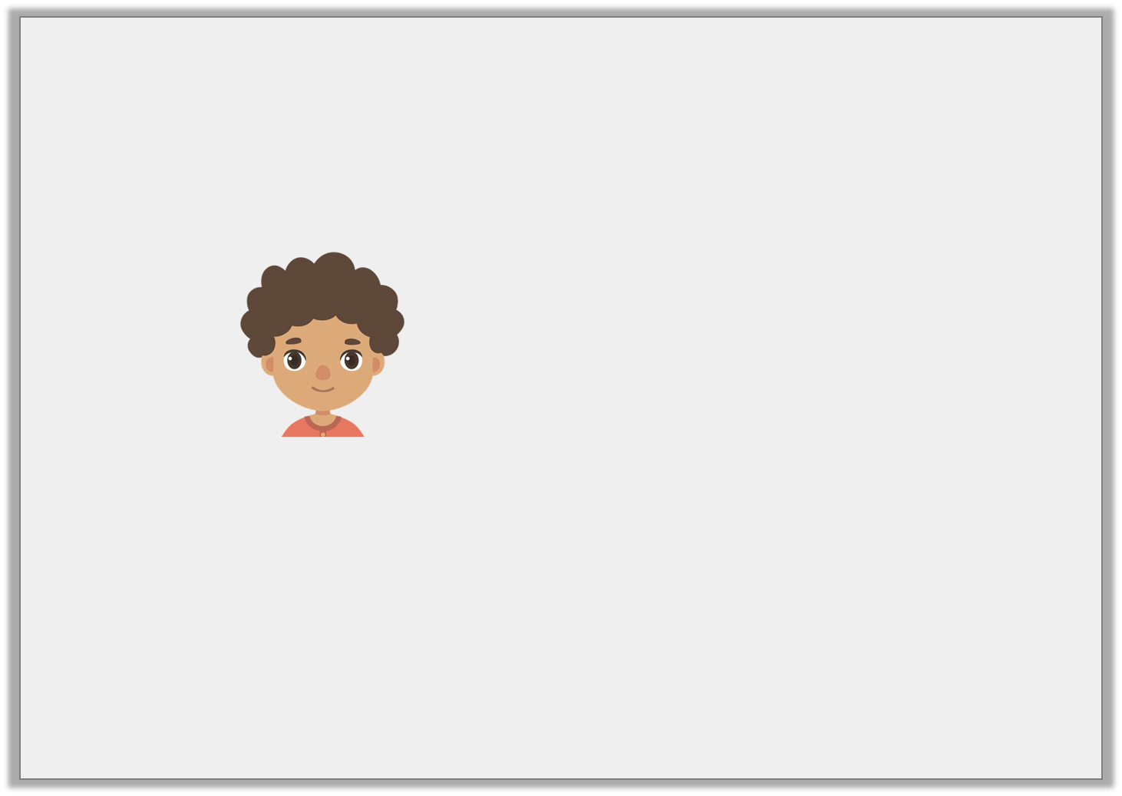
Reasoning 1
Billy is solving multiplications.
He says,
Is he correct? Explain your answer.
12 x 10 is the same as 10 x 12.
© Classroom Secrets Limited 2018

Slide 17
Reasoning 1
Billy is solving multiplications.
He says,
Is he correct? Explain your answer.
Billy is correct because…
12 x 10 is the same as 10 x 12.
© Classroom Secrets Limited 2018

Slide 18
Reasoning 1
Billy is solving multiplications.
He says,
Is he correct? Explain your answer.
Billy is correct because both 12 x 10 and 10 x 12 = 120.
12 x 10 is the same as 10 x 12.
© Classroom Secrets Limited 2018

Slide 19
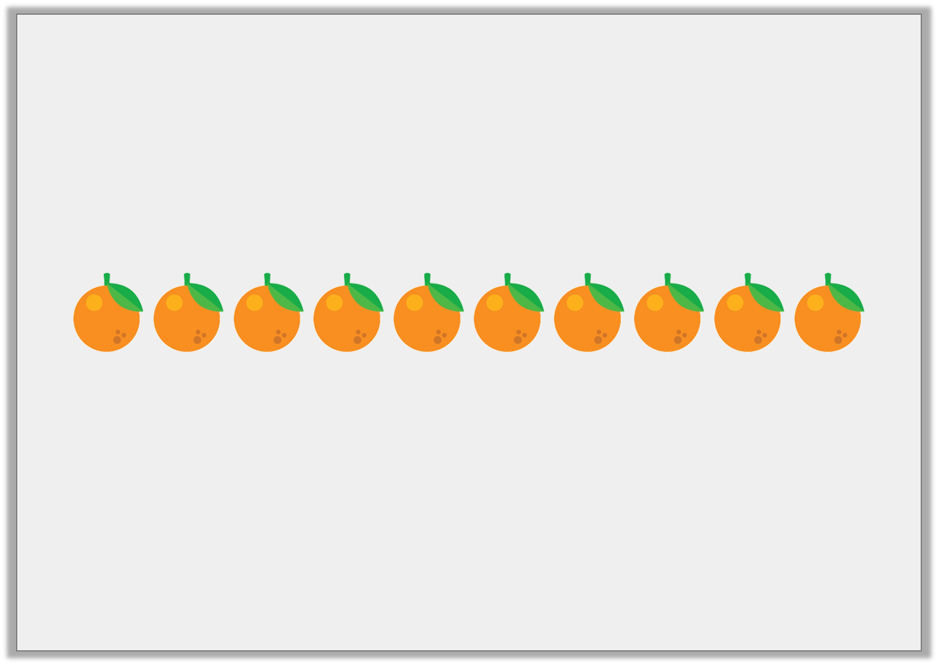
Reasoning 2
Oranges are sold in bags of 10.
Hannah buys 60 oranges.
How many bags did she buy?
If Hannah gives 2 bags to a friend, how many oranges will she have left? Explain how you know.
© Classroom Secrets Limited 2018

Slide 20
Reasoning 2
Oranges are sold in bags of 10.
Hannah buys 60 oranges.
How many bags did she buy?
If Hannah gives 2 bags to a friend, how many oranges will she have left? Explain how you know.
Hannah bought 6 bags of oranges. If she gives 2 bags to a friend she will have 40 oranges left because…
© Classroom Secrets Limited 2018

Slide 21
Reasoning 2
Oranges are sold in bags of 10.
Hannah buys 60 oranges.
How many bags did she buy?
If Hannah gives 2 bags to a friend, how many oranges will she have left? Explain how you know.
Hannah bought 6 bags of oranges. If she gives 2 bags to a friend she will have 40 oranges left because 6 – 2 = 4 and 4 x 10 = 40.
© Classroom Secrets Limited 2018

