Slide 1


LIFE/work balance
We have started a #LIFEworkbalance campaign and we need your help to complete our LIFE/work balance survey.
We hope to publish the results soon, so please give 15 minutes of your time to help us get a true picture of school life.
Want to be a part of this campaign? Take the survey on our website and share it with your colleagues!
© Classroom Secrets Limited 2019

Slide 2

Year 5/6 – Summer Block 2 – Position and Direction – Step 2
About This Resource:
This PowerPoint has been designed to support your teaching of this small step from the Mixed Age planning. It includes a starter activity suitable for each year group and an example of each question from the Varied Fluency and Reasoning and Problem Solving resources also provided in this pack (separate for each year group). Each slide has the year group identified in the bottom right-hand corner. We recommend that you look through this PowerPoint in advance and decide whether to work through all examples provided or a selection of them depending on the needs of your class.
National Curriculum Objectives:
Mathematics Year 6: (6P3) Describe positions on the full coordinate grid (all four quadrants)
More Year 5 and Year 6 Position and Direction resources.
Did you like this resource? Don’t forget to review it on our website.
© Classroom Secrets Limited 2019

Slide 3
Year 5/6 – Summer Block 2 – Position and Direction
Step 2
Year 6: Four Quadrants
© Classroom Secrets Limited 2019

Slide 4
Introduction
What are the coordinates for this shape?
8
7
6
5
4
3
2
1
0
0 | 1 | 2 | 3 | 4 | 5 | 6 | 7 | 8
Y6
© Classroom Secrets Limited 2019

Slide 5
Introduction
What are the coordinates for this shape?
(4,1), (2,4), (2,7), (6,7), (6,4)
8
7
6
5
4
3
2
1
0
0 | 1 | 2 | 3 | 4 | 5 | 6 | 7 | 8
Y6
© Classroom Secrets Limited 2019

Slide 6
Varied Fluency 1
Match coordinates with the points on the grid.
4
3
2
1
-1
-2
-3
-4
(2, 1)
(3, -2)
(-1, 2)
(-3, -3)
(-2, -4)
B
C
-4 | -3 | -2 | -1 |  |  | 1 | 2 | 3 | 4
D
A
Y6
© Classroom Secrets Limited 2019

Slide 7
Varied Fluency 1
Match coordinates with the points on the grid.
A (-3, -3), B (-1, 2), C (2, 1), D (3, -2)
4
3
2
1
-1
-2
-3
-4
(2, 1)
(3, -2)
(-1, 2)
(-3, -3)
(-2, -4)
B
C
-4 | -3 | -2 | -1 |  |  | 1 | 2 | 3 | 4
D
A
Y6
© Classroom Secrets Limited 2019

Slide 8
Varied Fluency 2
Write the coordinates of each shape.
E |  | F
 |  |  |  |  | A |  |  | B
G |  | H
 |  |  |  |  | C |  |  | D
4
3
2
1
-1
-2
-3
-4
-4 | -3 | -2 | -1 |  |  | 1 | 2 | 3 | 4
Y6
© Classroom Secrets Limited 2019

Slide 9
Varied Fluency 2
Write the coordinates of each shape.
A (2, 3), B (4, 3), C (2, 1), D (4, 1),
E (-3, 4), F (-2, 4), G (-3, 2), H (-2, 2)
E |  | F
 |  |  |  |  | A |  |  | B
G |  | H
 |  |  |  |  | C |  |  | D
4
3
2
1
-1
-2
-3
-4
-4 | -3 | -2 | -1 |  |  | 1 | 2 | 3 | 4
Y6
© Classroom Secrets Limited 2019

Slide 10
Varied Fluency 3
Plot the coordinates to draw the shapes. Which shapes have you drawn?
(-4, -1)
(-1, -1)
(-4, -3)
(-1, -3)
4
3
2
1
-1
-2
-3
-4
-4 | -3 | -2 | -1 |  |  | 1 | 2 | 3 | 4
(2, 0)
(1, -2)
(2, -4)
(3, -2)
Y6
© Classroom Secrets Limited 2019

Slide 11
Varied Fluency 3
Plot the coordinates to draw the shapes. Which shapes have you drawn?
A
(-4, -1)
(-1, -1)
(-4, -3)
(-1, -3)
4
3
2
1
-1
-2
-3
-4
-4 | -3 | -2 | -1 |  |  | 1 | 2 | 3 | 4
B
A
B
(2, 0)
(1, -2)
(2, -4)
(3, -2)
Y6
© Classroom Secrets Limited 2019

Slide 12
Reasoning 1
George thinks that the coordinates below make a kite. Is he correct? Explain why.
5
4
3
2
1
-1
-2
-3
-4
-5
(-4, 1)
(-3, 2)
(-2, 1)
(-3, 0)
-5 | -4 | -3 | -2 | -1 |  |  | 1 | 2 | 3 | 4 | 5
Y6
© Classroom Secrets Limited 2019

Slide 13
Reasoning 1
George thinks that the coordinates below make a kite. Is he correct? Explain why.
5
4
3
2
1
-1
-2
-3
-4
-5
(-4, 1)
(-3, 2)
(-2, 1)
(-3, 0)
-5 | -4 | -3 | -2 | -1 |  |  | 1 | 2 | 3 | 4 | 5
George is not correct because…
Y6
© Classroom Secrets Limited 2019

Slide 14
Reasoning 1
George thinks that the coordinates below make a kite. Is he correct? Explain why.
5
4
3
2
1
-1
-2
-3
-4
-5
(-4, 1)
(-3, 2)
(-2, 1)
(-3, 0)
-5 | -4 | -3 | -2 | -1 |  |  | 1 | 2 | 3 | 4 | 5
George is not correct because either (-4, 1) should be (-5, 1) or
(-2, 1) should be (-1, 1).
Y6
© Classroom Secrets Limited 2019

Slide 15
Problem Solving 1
Follow the clues. What could the coordinates of the shape be?
The shape is a
parallelogram.
The shape is
in one quadrant.
One of the
points is (5, -1).
5
4
3
2
1
-1
-2
-3
-4
-5
-5 | -4 | -3 | -2 | -1 |  |  | 1 | 2 | 3 | 4 | 5
Y6
© Classroom Secrets Limited 2019

Slide 16
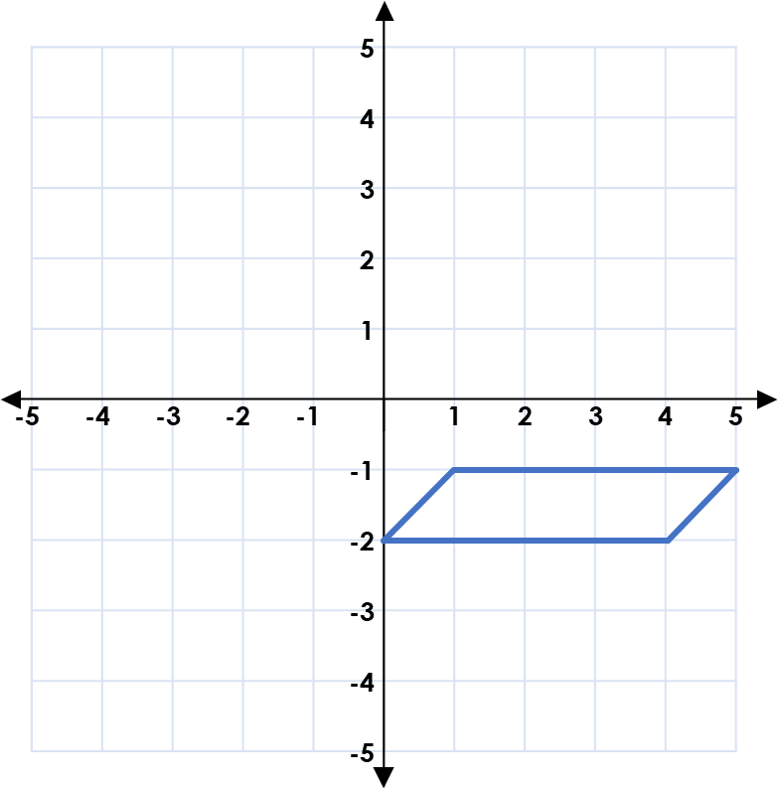
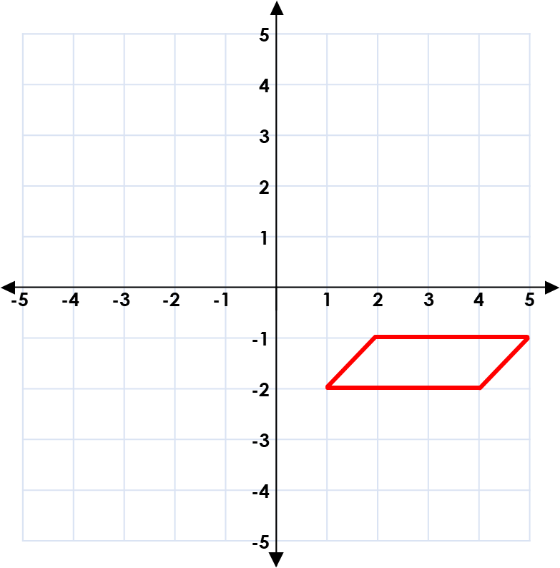
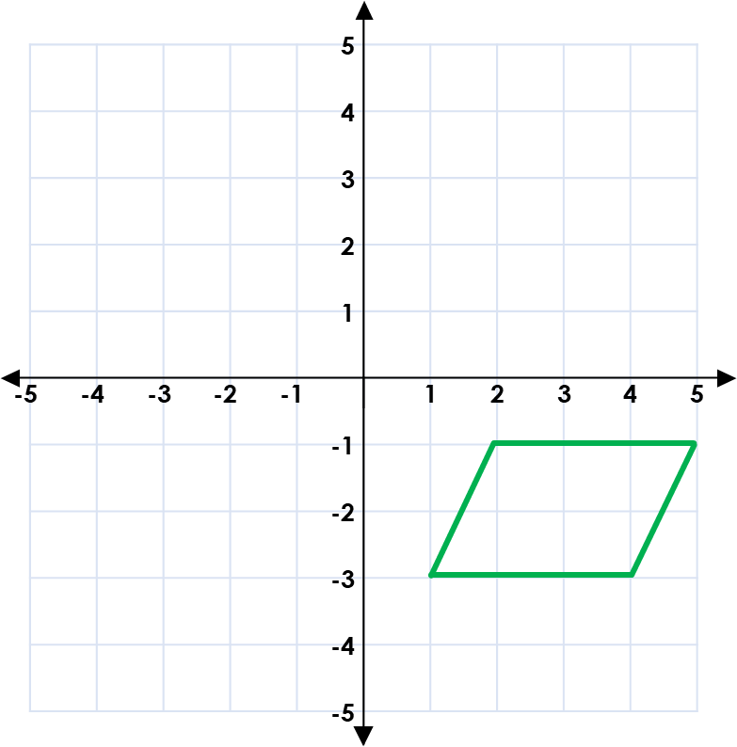
Problem Solving 1
Follow the clues. What could the coordinates of the shape be?
The shape is a
parallelogram.
The shape is
in one quadrant.
One of the
points is (5, -1).
Various answers including:
(5, -1); (4, -2); (0, -2); (1, -1)
(5, -1); (4, -2); (1, -2); (2, -1)
(5, -1); (4, -3); (1, -3); (2, -1)
Y6
© Classroom Secrets Limited 2019

Slide 17
Reasoning 2
Here is a trapezium. It has one line of symmetry.
Write the coordinates of points A and B.
5
4
3
2
1
-1
-2
-3
-4
-5
B
 |  |  |  |  | A
-5 | -4 | -3 | -2 | -1 |  |  | 1 | 2 | 3 | 4 | 5
Y6
© Classroom Secrets Limited 2019

Slide 18
Reasoning 2
Here is a trapezium. It has one line of symmetry.
Write the coordinates of points A and B. A = (0, -4), B = (-4, -1)
5
4
3
2
1
-1
-2
-3
-4
-5
B
 |  |  |  |  | A
-5 | -4 | -3 | -2 | -1 |  |  | 1 | 2 | 3 | 4 | 5
Y6
© Classroom Secrets Limited 2019

