Slide 1


Year 5 – Summer Block 3 – Position and Direction – Reflection
About This Resource:
This PowerPoint has been designed to support your teaching of this small step. It includes a starter activity and an example of each question from the Varied Fluency and Reasoning and Problem Solving resources also provided in this pack. You can choose to work through all examples provided or a selection of them depending on the needs of your class.
National Curriculum Objectives:
Mathematics Year 5: (5P2) Identify, describe and represent the position of a shape following a reflection or translation, using the appropriate language, and know that the shape has not changed
More Year 5 Position and Direction resources.
Did you like this resource? Don’t forget to review it on our website.
© Classroom Secrets Limited 2018

Slide 2
Year 5 – Summer Block 3 – Position and Direction
Step 2: Reflection
© Classroom Secrets Limited 2018

Slide 3
Introduction
Plot the coordinates on the grid to create
a shape and its reflection.
10
9
8
7
6
5
4
3
2
1
0
Shape:
(4, 7)
(2, 7)
(1, 3)
(3, 3)
Reflection:
(6, 7)
(8, 7)
(9, 3)
(7, 3)
0 | 1 | 2 | 3 | 4 | 5 | 6 | 7 | 8 | 9 | 10
© Classroom Secrets Limited 2018

Slide 4
Introduction
Plot the coordinates on the grid to create
a shape and its reflection.
10
9
8
7
6
5
4
3
2
1
0
Shape:
(4, 7)
(2, 7)
(1, 3)
(3, 3)
Reflection:
(6, 7)
(8, 7)
(9, 3)
(7, 3)
0 | 1 | 2 | 3 | 4 | 5 | 6 | 7 | 8 | 9 | 10
© Classroom Secrets Limited 2018

Slide 5
Varied Fluency 1
Are the reflected images correct or incorrect?
A.
B.
© Classroom Secrets Limited 2018

Slide 6
Varied Fluency 1
Are the reflected images correct or incorrect?
A.
Shape A is incorrect.
B.
Shape B is correct.
© Classroom Secrets Limited 2018

Slide 7
Varied Fluency 2
Reflect the shapes in the mirror line.
© Classroom Secrets Limited 2018

Slide 8
Varied Fluency 2
Reflect the shapes in the mirror line.
© Classroom Secrets Limited 2018

Slide 9
Varied Fluency 3
Reflect the points in the mirror line.
Write the coordinates of the reflected points.
8
7
6
5
4
3
2
1
0
 |  |  |  |  |  |  |  | A
 |  |  | B
 |  | C
 |  |  |  |  | D
0 | 1 | 2 | 3 | 4 | 5 | 6 | 7 | 8 | 9 | 10
© Classroom Secrets Limited 2018

Slide 10
Varied Fluency 3
Reflect the points in the mirror line.
Write the coordinates of the reflected points.
8
7
6
5
4
3
2
1
0
 |  |  |  |  |  |  |  | A
 |  |  | B
 |  | C
 |  |  |  |  | D
A: (1, 8)
B: (6, 6)
C: (7, 3)
D: (4, 0)
0 | 1 | 2 | 3 | 4 | 5 | 6 | 7 | 8 | 9 | 10
© Classroom Secrets Limited 2018

Slide 11
Varied Fluency 4
Tick the image showing the correct reflection.
A.
B.
© Classroom Secrets Limited 2018

Slide 12
Varied Fluency 4
Tick the image showing the correct reflection.
A.
B.
✓
© Classroom Secrets Limited 2018

Slide 13
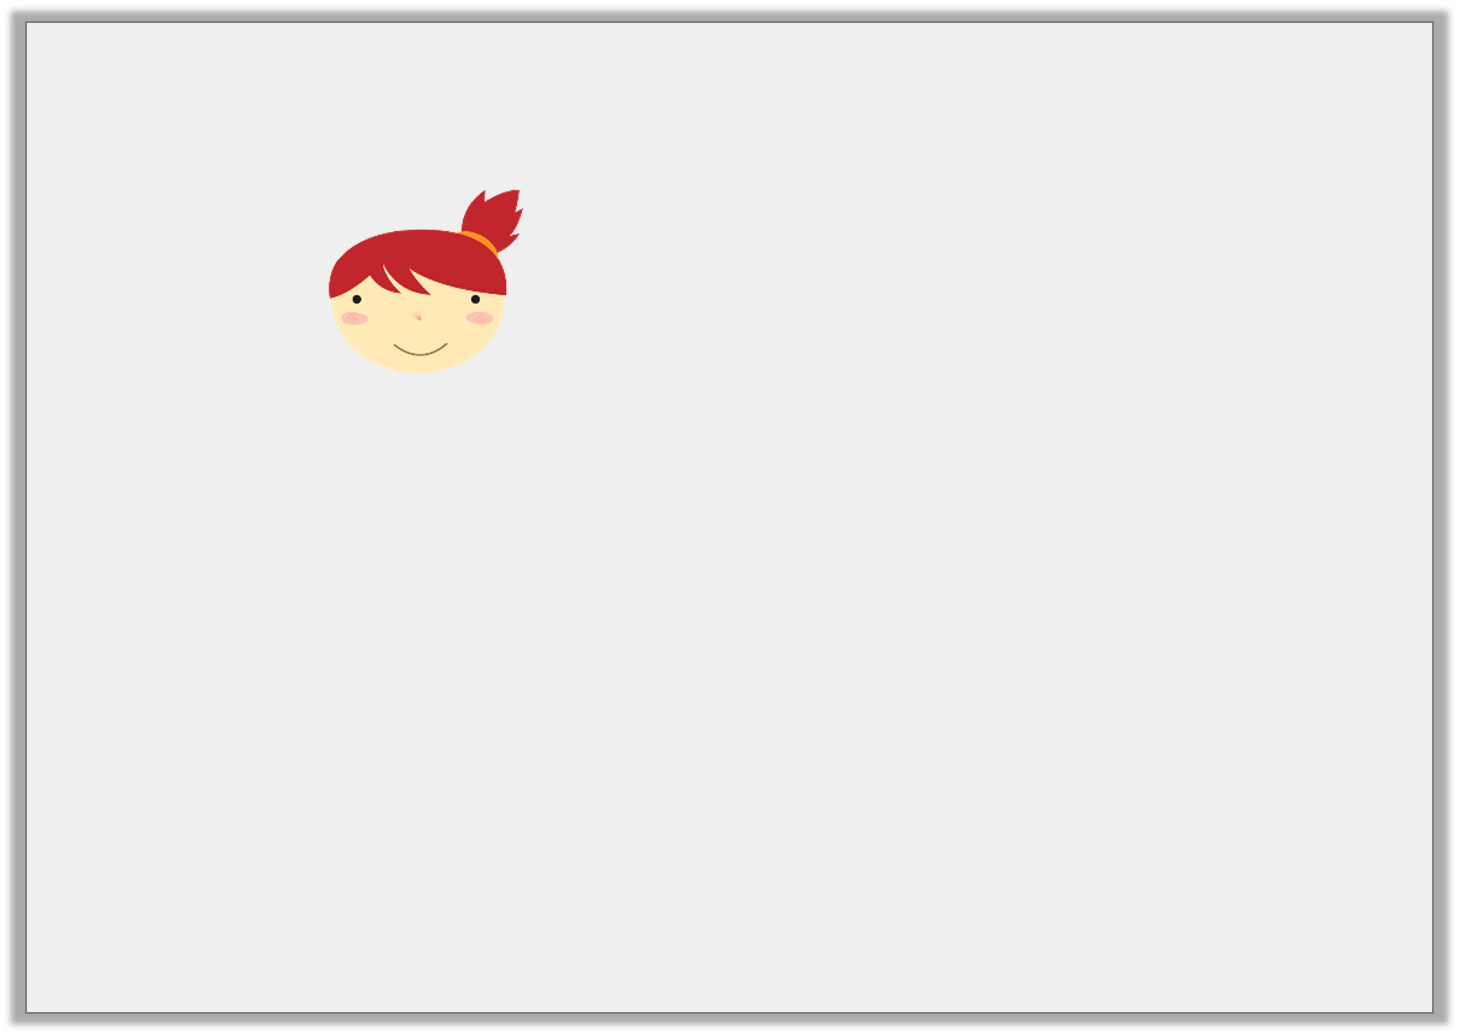
Reasoning 1
Susan has reflected three shapes.
Do you agree? Explain your answer.
I’ve reflected by making sure the shapes in the same place in the mirror line.
© Classroom Secrets Limited 2018

Slide 14
Reasoning 1
Susan has reflected three shapes.
Do you agree? Explain your answer.
Susan is incorrect because…
I’ve reflected by making sure the shapes in the same place in the mirror line.
© Classroom Secrets Limited 2018

Slide 15
Reasoning 1
Susan has reflected three shapes.
Do you agree? Explain your answer.
Susan is incorrect because although it works for the hexagon, the other two shapes have only been moved, not reflected.
I’ve reflected by making sure the shapes in the same place in the mirror line.
© Classroom Secrets Limited 2018

Slide 16
Problem Solving 1
Draw the mirror line so that the reflection is accurate.
© Classroom Secrets Limited 2018

Slide 17
Problem Solving 1
Draw the mirror line so that the reflection is accurate.
© Classroom Secrets Limited 2018

Slide 18
Problem Solving 2
Put a cross on the mistakes in the reflection below.
reflection
© Classroom Secrets Limited 2018

Slide 19
Problem Solving 2
Put a cross on the mistakes in the reflection below.
reflection
© Classroom Secrets Limited 2018

