Slide 1


Slide 3
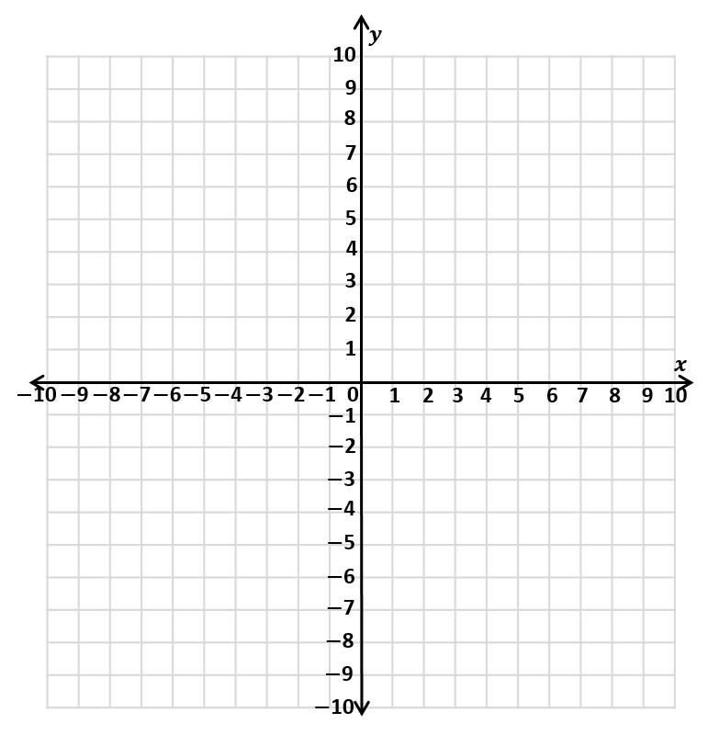
1) Translate shape A
2 left and 4 down.
2) Write the coordinates
of each vertex of the
translated shape.
3) Describe the translation
from shape A to C.
A
C

Slide 4
1) Translate shape A
2 left and 4 down.
2) Write the coordinates
of each vertex of the
translated shape.
3) Describe the translation
from shape A to C.
A
C
(0,2) (5,2) (0,5) (5,5)
9 left and 11 down.

Slide 6
Reflections

Slide 7


What’s changed?
What’s stayed the same?
Have a think

Slide 8






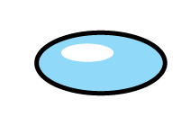

Which images are reflections? Which images are not?
Have a think

Slide 9
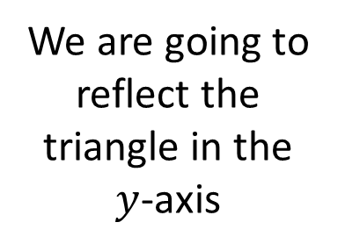
2 away
We are going to reflect the triangle in the $y$-axis
5 away

Slide 10
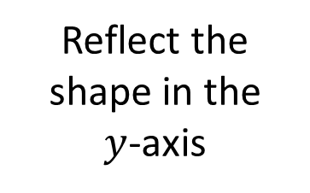
Have a think
5 away
2 away
Reflect the shape in the
$y$-axis
6 away
3 away

Slide 11
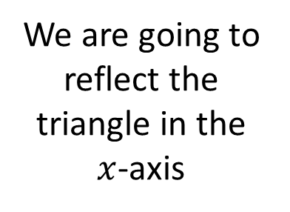
We are going to reflect the triangle in the $x$-axis
6 away
2 away
2 away

Slide 12
Have a go at questions 1 - 4 on the worksheet

Slide 13


Have a think
C
Reflect shape B in the line $y=$ 1
Reflect shape A in the line $x=$ 1
B
A

Slide 14





$$y$$
Have a think
$($3,9$)$
$$p$$
$$x$$
The triangle is reflected in the $y$-axis.
What will be the coordinate of the vertex $p$?

Slide 15
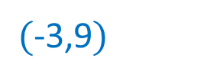
$$y$$
$($3,9$)$
$$p$$
$($-3,9$)$
9
$$x$$
-3
3
The triangle is reflected in the $y$-axis.
What will be the coordinate of the vertex $p$?

Slide 16


$$y$$
Have a think
$($3,9$)$
$$x$$
$$p$$
The triangle is reflected in the $x$-axis.
What will be the coordinate of the vertex $p$?

Slide 17

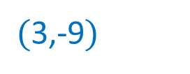
$$y$$
$($3,9$)$
9
$$x$$
3
-9
$$p$$
$($3,-9$)$
The triangle is reflected in the $x$-axis.
What will be the coordinate of the vertex $p$?

Slide 18
Have a go at the rest of the questions on the worksheet

