Slide 3
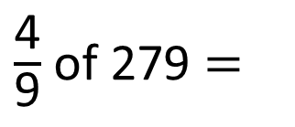
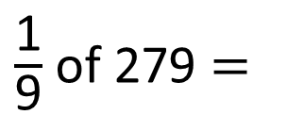
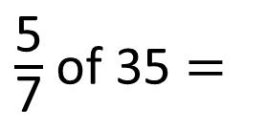
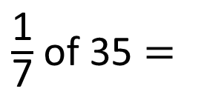
1)
2)
3)
4)
$\frac{\text{1}}{\text{7}}$ of 35 $=$
35
$\frac{\text{5}}{\text{7}}$ of 35 $=$
$\frac{\text{1}}{\text{9}}$ of 279 $=$
279
$\frac{\text{4}}{\text{9}}$ of 279 $=$

Slide 4
1)
2)
3)
4)
$\frac{\text{1}}{\text{7}}$ of 35 $=$
5
35
5
5
5
5
5
$\frac{\text{5}}{\text{7}}$ of 35 $=$
25
?
$\frac{\text{1}}{\text{9}}$ of 279 $=$
279
31
31
31
31
31
$\frac{\text{4}}{\text{9}}$ of 279 $=$
124

Slide 6
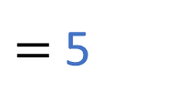

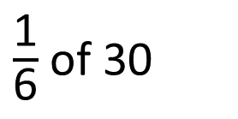

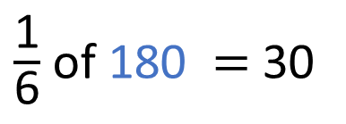
$\frac{\text{1}}{\text{6}}$ of 30
$=$ 5
$\frac{\text{1}}{\text{6}}$ of 180 $=$ 30
30
180
?
5
30
30
30
30
30
30
?
30
30 $÷$ 6 $=$
5
30 $×$ 6 $=$
180

Slide 7
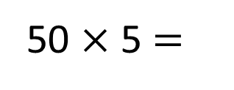
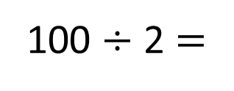
$\frac{\text{2}}{\text{5}}$ of 250 $=$ 100
Have a think
250
?
50
50
50
50
50
100
100 $÷$ 2 $=$
50
50 $×$ 5 $=$
250

Slide 8
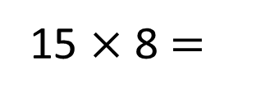
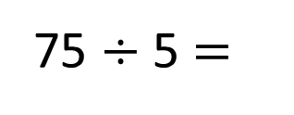
Mo spent $\frac{\text{5}}{\text{8}}$ of his money on a new bike.
Have a think
He spent £75
How much money did Mo have to begin with?
£120
?
15
15
15
15
15
15
15
15
£75
75 $÷$ 5 $=$
15
15 $×$ 8 $=$
120

Slide 9
Have a go at questions 1 - 4 on the worksheet

Slide 10
A number of people voted on their favourite city.
Here are the results:
London
Tokyo
Paris
Pisa
$$\frac{\text{1}}{\text{4}}$$
$$\frac{\text{1}}{\text{10}}$$
$$\frac{\text{3}}{\text{5}}$$
$$\frac{\text{1}}{\text{20}}$$
125 people voted for London
How many people voted for Pisa?
Have a think

Slide 11
A number of people voted on their favourite city.
Here are the results:
London
Tokyo
Paris
Pisa
$$\frac{\text{1}}{\text{4}}$$
$$\frac{\text{1}}{\text{10}}$$
$$\frac{\text{3}}{\text{5}}$$
$$\frac{\text{1}}{\text{20}}$$
125 people voted for London
$\frac{\text{1}}{\text{4}}$ of 500 $=$ 125
How many people voted for Pisa?
500
?
125
125
125
125
125

Slide 12
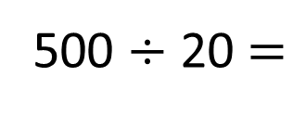
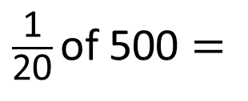
A number of people voted on their favourite city.
Here are the results:
500
London
Tokyo
Paris
Pisa
$$\frac{\text{1}}{\text{4}}$$
$$\frac{\text{1}}{\text{10}}$$
$$\frac{\text{3}}{\text{5}}$$
$$\frac{\text{1}}{\text{20}}$$
125 people voted for London
How many people voted for Pisa?
$\frac{\text{1}}{\text{20}}$ of 500 $=$
25
500 $÷$ 20 $=$
25

Slide 13
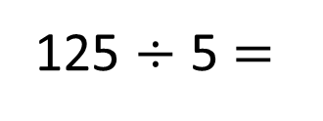
A number of people voted on their favourite city.
Here are the results:
500
London
Tokyo
Paris
Pisa
$$\frac{\text{1}}{\text{4}}$$
$$\frac{\text{1}}{\text{10}}$$
$$\frac{\text{3}}{\text{5}}$$
$$\frac{\text{1}}{\text{20}}$$
125 people voted for London
How many people voted for Pisa?
125 $÷$ 5 $=$
25
London
$\frac{\text{1}}{\text{20}}$ of 500 $=$
25
500 $÷$ 20 $=$
25
Pisa

Slide 14
Mo pours $\frac{\text{2}}{\text{5}}$ of a full bottle of orange juice into
an empty glass.
The glass now has 500 ml of orange juice in it.
How many ml of orange juice are left in the bottle?
750 ml
250
250
250
250
250
500
750
?
Have a think

Slide 15
Have a go at the rest of the questions on the worksheet

