Slide 1
Year 5/6 – Spring Block 1 – Fractions – Step 7
About This Resource:
This PowerPoint has been designed to support your teaching of this small step from the Mixed Age planning. It includes a starter activity suitable for each year group and an example of each question from the Varied Fluency and Reasoning and Problem Solving resources also provided in this pack (separate for each year group). Each slide has the year group identified in the bottom right-hand corner. We recommend that you look through this PowerPoint in advance and decide whether to work through all examples provided or a selection of them depending on the needs of your class.
National Curriculum Objectives:
Mathematics Year 5: (5F4) Add and subtract fractions with the same denominator and denominators that are multiples of the same number
Mathematics Year 5: (5F2a) Recognise mixed numbers and improper fractions and convert from one form to the other and write mathematical statements > 1 as a mixed number [for example, 2/5 + 4/5 = 6/5 = 1 1/5 ]
Mathematics Year 6: (6F2) Use common factors to simplify fractions; use common multiples to express fractions in the same denomination
Mathematics Year 6: (6F4) Add and subtract fractions with different denominators and mixed numbers, using the concept of equivalent fractions
Mathematics Year 6: (6F11) Recall and use equivalences between simple fractions, decimals and percentages, including in different contexts
More Year 5 and Year 6 Fractions resources.
Did you like this resource? Don’t forget to review it on our website.
© Classroom Secrets Limited 2018

Slide 2
Year 5/6 – Spring Block 1 – Fractions
Step 7
Year 5: Add and Subtract Fractions
Year 6: Add and Subtract Fractions 1
© Classroom Secrets Limited 2018

Slide 3
Introduction
Identify the fractions represented by the bar models below.
Use >, < or = to compare them.
A)
B)
or
Y5
© Classroom Secrets Limited 2018

Slide 4
Introduction
Identify the fractions represented by the bar models below.
Use >, < or = to compare them.
A)
B)
or
7
4
13
8
13
8
7
4
>
<
Y5
© Classroom Secrets Limited 2018

Slide 5
Introduction
Which of these fractions is the odd one out?
Explain why.
3 |  | 8 |  | 5 |  | 2 |  | 10
12 |  | 16 |  | 20 |  | 8 |  | 40
Y6
© Classroom Secrets Limited 2018

Slide 6
Introduction
Which of these fractions is the odd one out?
Explain why.
All the other fractions simplify to .
3 |  | 8 |  | 5 |  | 2 |  | 10
12 |  | 16 |  | 20 |  | 8 |  | 40
1
4
Y6
© Classroom Secrets Limited 2018

Slide 7
Varied Fluency 1
True or false? The following calculation is correct.
4 | + | 3 | = | 7 | = | 1 | 1
5 |  | 5 |  | 5 |  |  | 5
Y5
© Classroom Secrets Limited 2018

Slide 8
Varied Fluency 1
True or false? The following calculation is correct.
False. The answer is
4 | + | 3 | = | 7 | = | 1 | 1
5 |  | 5 |  | 5 |  |  | 5
1 | 2
 | 5
Y5
© Classroom Secrets Limited 2018

Slide 9
Varied Fluency 2
Match the image to the correct answer.
+
A) | 1 | 1 | B) | 1 | 3 | C) | 8
 |  | 7 |  |  | 7 |  | 14
Y5
© Classroom Secrets Limited 2018

Slide 10
Varied Fluency 2
Match the image to the correct answer.
+
A) | 1 | 1 | B) | 1 | 3 | C) | 8
 |  | 7 |  |  | 7 |  | 14
Y5
© Classroom Secrets Limited 2018

Slide 11
Varied Fluency 3
Calculate the following:
8 | – | 3 | =
9 |  | 9
Y5
© Classroom Secrets Limited 2018

Slide 12
Varied Fluency 3
Calculate the following:
8 | – | 3 | = | 5
9 |  | 9 |  | 9
Y5
© Classroom Secrets Limited 2018

Slide 13
Varied Fluency 4
Giles drinks of his milk.
Jilly drinks of her milk.
How much milk have they drunk altogether?
Record your answer as a fraction.
9
11
8
11
Y5
© Classroom Secrets Limited 2018

Slide 14
Varied Fluency 4
Giles drinks of his milk.
Jilly drinks of her milk.
How much milk have they drunk altogether?
Record your answer as a fraction.
9
11
8
11
1 | 6
 | 11
Y5
© Classroom Secrets Limited 2018

Slide 15
Varied Fluency 1
Find the lowest common denominator for the fractions below.
1 |  | 2 |  | 3 |  | 5
2 |  | 3 |  | 4 |  | 6
Y6
© Classroom Secrets Limited 2018

Slide 16
Varied Fluency 1
Find the lowest common denominator for the fractions below.
12
1 |  | 2 |  | 3 |  | 5
2 |  | 3 |  | 4 |  | 6
6
12
8
12
9
12
10
12
Y6
© Classroom Secrets Limited 2018

Slide 17
Varied Fluency 2
Fill in the missing numerator.
3 | + |  | = | 11
4 |  | 6 |  | 12
Y6
© Classroom Secrets Limited 2018

Slide 18
Varied Fluency 2
Fill in the missing numerator.
3 | + | 1 | = | 11
4 |  | 6 |  | 12
Y6
© Classroom Secrets Limited 2018

Slide 19
Varied Fluency 3
Complete the calculation.
Give your answer in its simplest form.
8 | + | 20 | =
25 |  | 50
Y6
© Classroom Secrets Limited 2018

Slide 20
Varied Fluency 3
Complete the calculation.
Give your answer in its simplest form.
8 | + | 20 | = | 18
25 |  | 50
 |  |  |  | 25
Y6
© Classroom Secrets Limited 2018

Slide 21
Varied Fluency 4
Complete the addition related to the image.
Give your answer in its simplest form.
+ |  |  |  |  | = | ?
 | + |  | =
Y6
© Classroom Secrets Limited 2018

Slide 22
Varied Fluency 4
Complete the addition related to the image.
Give your answer in its simplest form.
+ |  |  |  |  | = | ?
5 | + | 4 | = | 4
18 |  | 24 |  | 9
Y6
© Classroom Secrets Limited 2018

Slide 23
Varied Fluency 5
A contestant in a bike race covers of the race in the first 30 minutes, in the next 50 minutes and in another 30 minutes.
How far has she covered in the first hour and 50 minutes?
2
9
1
3
1
6
Y6
© Classroom Secrets Limited 2018

Slide 24
Varied Fluency 5
A contestant in a bike race covers of the race in the first 30 minutes, in the next 50 minutes and in another 30 minutes.
How far has she covered in the first hour and 50 minutes?
2
9
1
3
1
6
2 | + | 1 | + | 1 | = | 8 | + | 12 | + | 6 | = | 26 | = | 13
9 |  | 3 |  | 6 |  | 36 |  | 36 |  | 36 |  | 36 |  | 18
Y6
© Classroom Secrets Limited 2018

Slide 25
Reasoning 1
Trisha is calculating the missing numerator in the following calculation:
Is she correct? Explain why.
 | + | 7 | = | 1 | 3
12 |  | 12 |  |  | 12
I think the missing numerator must be 10.
Y5
© Classroom Secrets Limited 2018

Slide 26
Reasoning 1
Trisha is calculating the missing numerator in the following calculation:
Is she correct? Explain why.
Trisha is incorrect because...
 | + | 7 | = | 1 | 3
12 |  | 12 |  |  | 12
I think the missing numerator must be 10.
Y5
© Classroom Secrets Limited 2018

Slide 27
Reasoning 1
Trisha is calculating the missing numerator in the following calculation:
Is she correct? Explain why.
Trisha is incorrect because the numerators need to total 15, so the missing numerator must be 8.
8 | + | 7 | = | 1 | 3
12 |  | 12 |  |  | 12
I think the missing numerator must be 10.
Y5
© Classroom Secrets Limited 2018

Slide 28
Problem Solving 1
Insert the following symbols to make the
equations correct: >, < or =
15 | – | 7
11 |  | 11
7 | + | 2
11 |  | 11
5 | + | 6
12 |  | 12
15 | – | 4
12 |  | 12
Y5
© Classroom Secrets Limited 2018

Slide 29
Problem Solving 1
Insert the following symbols to make the
equations correct: >, < or =
15 | – | 7
11 |  | 11
7 | + | 2
11 |  | 11
<
5 | + | 6
12 |  | 12
15 | – | 4
12 |  | 12
=
Y5
© Classroom Secrets Limited 2018

Slide 30
Problem Solving 2
Complete the fractions to make the calculation correct.
 | + |  | = | 1 | 2
 |  |  |  |  | 7
Y5
© Classroom Secrets Limited 2018

Slide 31
Problem Solving 2
Complete the fractions to make the calculation correct.
Any combination where the numerators total 9
and the denominator is 7. e.g.
5 | + | 4 | = | 1 | 2
7 |  | 7 |  |  | 7
Y5
© Classroom Secrets Limited 2018

Slide 32
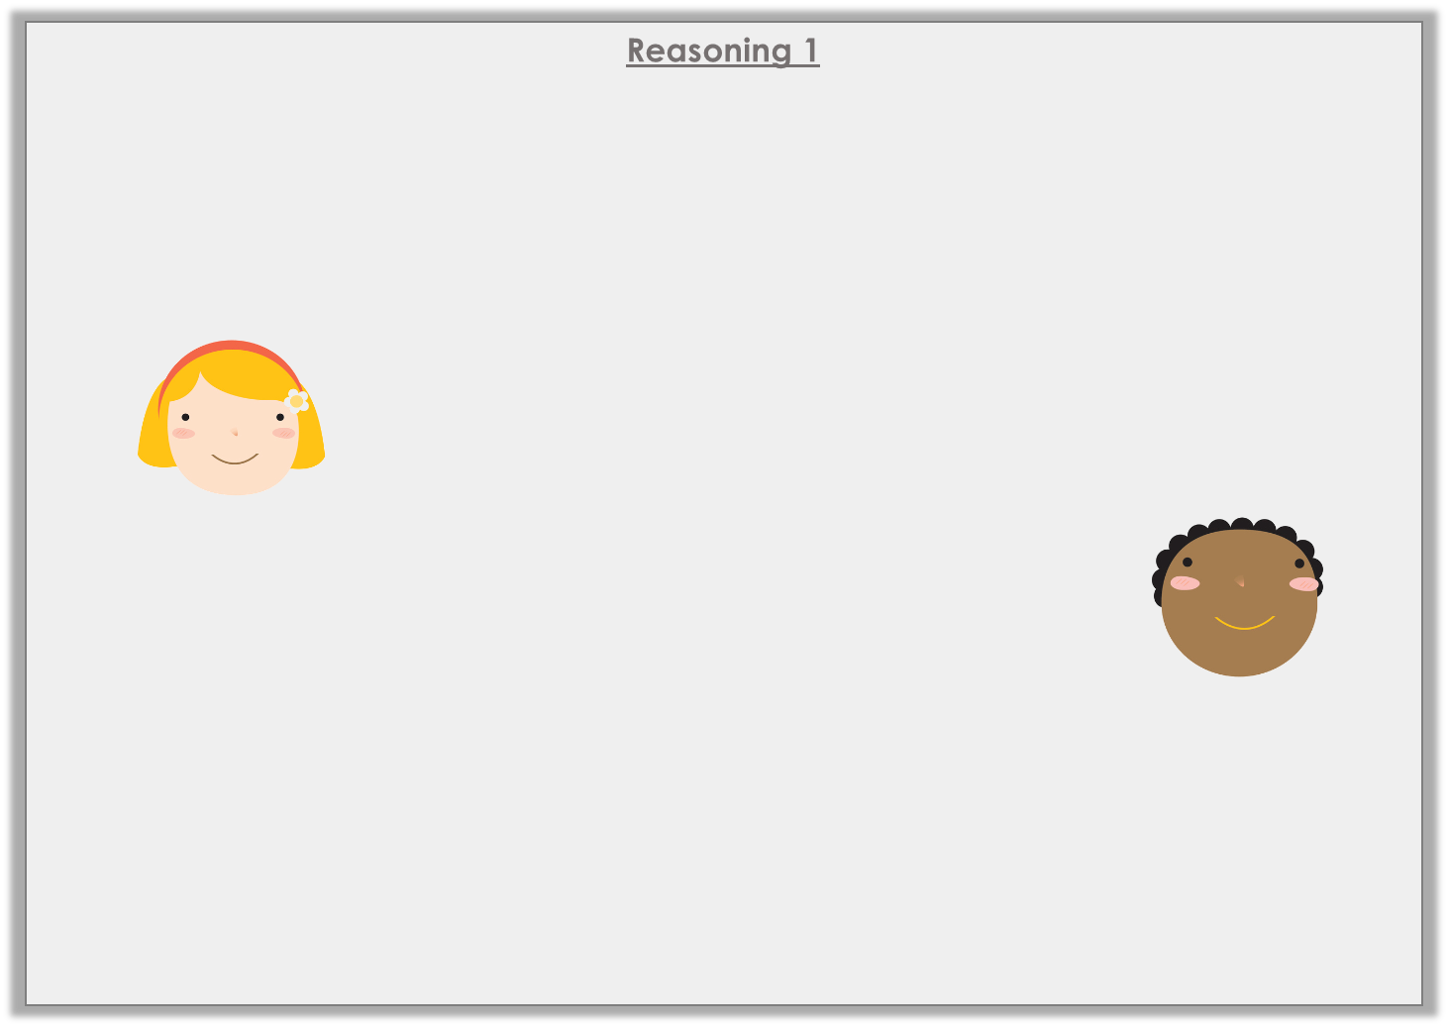
Reasoning 1
Look at the subtraction below.
Who is correct? Prove it.
6 | – | 1 | = | 14
8 |  | 6 |  | 24
The answer should be .
7
12
Grace
The answer is wrong. It should be .
5
2
Haydn
Y6
© Classroom Secrets Limited 2018

Slide 33
Reasoning 1
Look at the subtraction below.
Who is correct? Prove it.
Grace is correct because…
6 | – | 1 | = | 14
8 |  | 6 |  | 24
The answer should be .
7
12
Grace
The answer is wrong. It should be .
5
2
Haydn
Y6
© Classroom Secrets Limited 2018

Slide 34
Reasoning 1
Look at the subtraction below.
Who is correct? Prove it.
Grace is correct because she has simplified the answer. Haydn has not found a common denominator before subtracting the digits.
6 | – | 1 | = | 14
8 |  | 6 |  | 24
The answer should be .
7
12
Grace
The answer is wrong. It should be .
5
2
Haydn
Y6
© Classroom Secrets Limited 2018

Slide 35
Problem Solving 1
Write two addition or subtraction calculations using three of the following fractions.
9
10
1
4
8
40
13
20
Y6
© Classroom Secrets Limited 2018

Slide 36
Problem Solving 1
Write two addition or subtraction calculations using three of the following fractions.
Possible answers:
9
10
1
4
8
40
13
20
9 | - | 1 | = | 13
10 |  | 4 |  | 20
13 | + | 1 | = | 9
20 |  | 4 |  | 10
Y6
© Classroom Secrets Limited 2018

Slide 37
Problem Solving 2
Complete the part whole model.
A
1
5
C
3
25
B
3
7
1
5
Y6
© Classroom Secrets Limited 2018

Slide 38
Problem Solving 2
Complete the part whole model.
29
35
29
35
1
5
22
35
3
25
2
25
3
7
1
5
Y6
© Classroom Secrets Limited 2018

