Slide 1
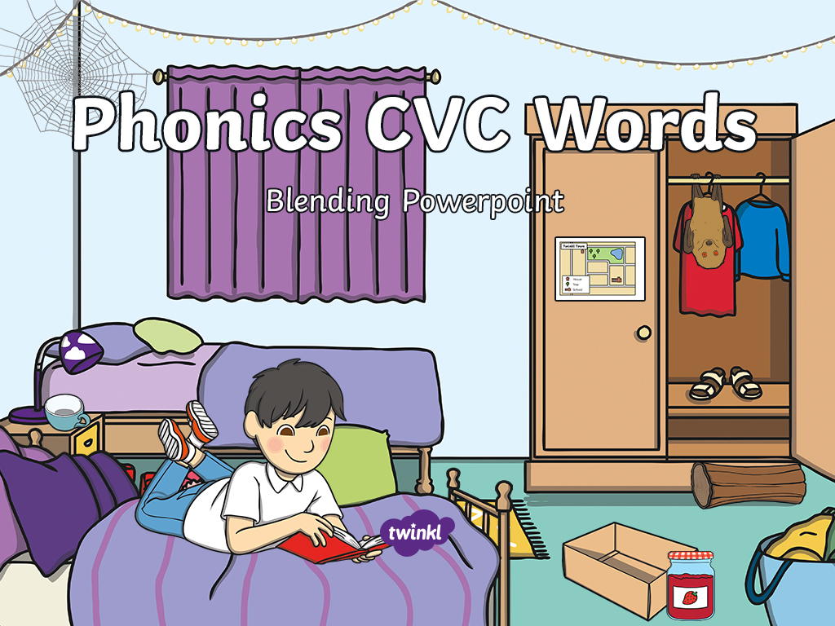

Slide 2

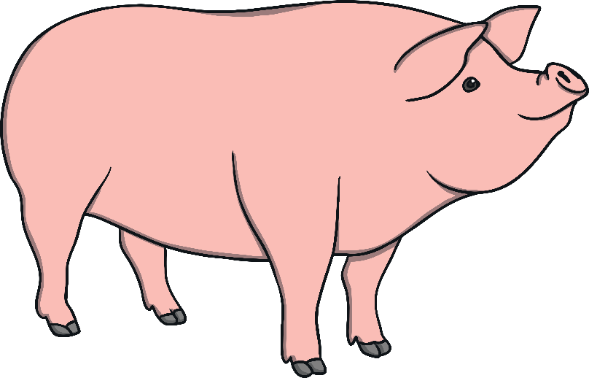
p
i
g

Slide 3

j
a
m

Slide 4
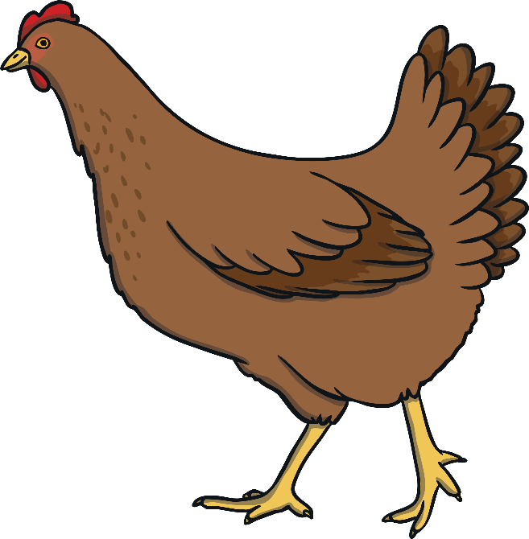
h
e
n

Slide 5
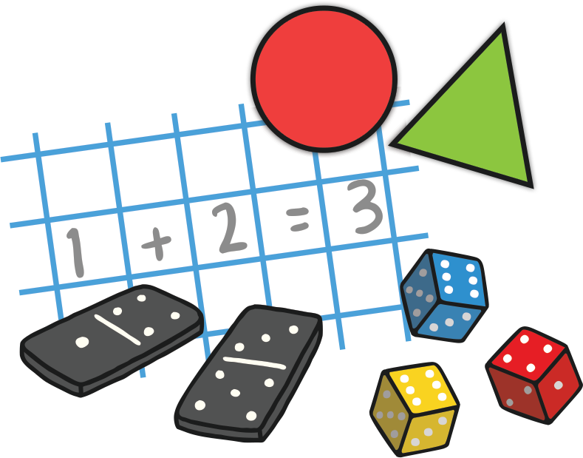
s
u
m

Slide 6
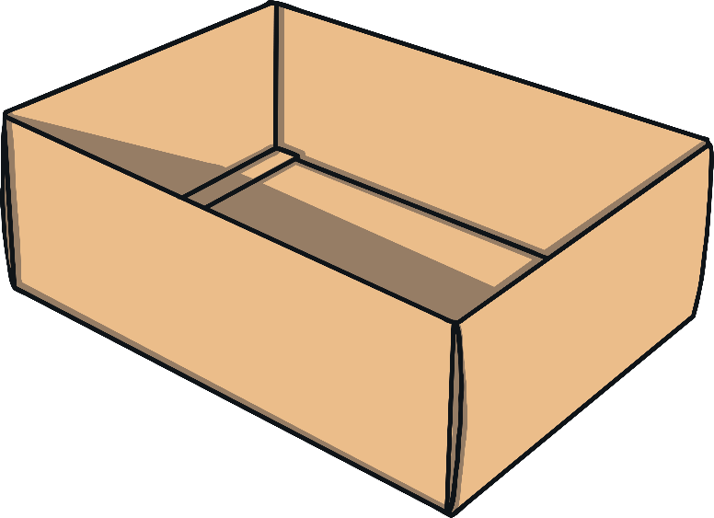
b
o
x

Slide 7
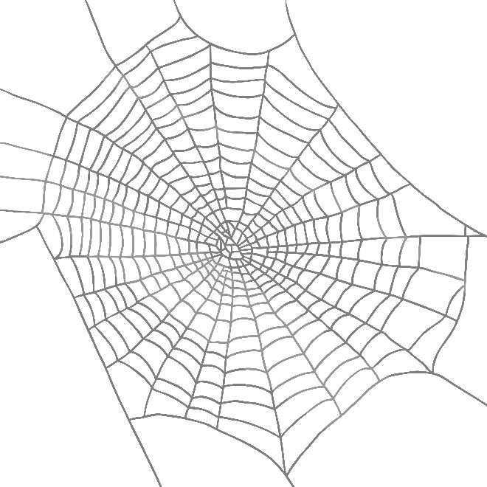
w
e
b

Slide 8

b
e
d

Slide 9
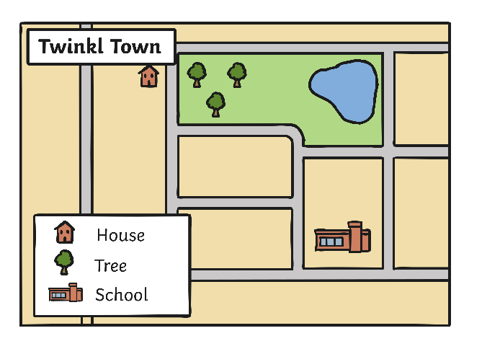
m
a
p

Slide 10

t
i
n

Slide 11

l
o
g

Slide 12

c
u
p

Slide 13

b
a
t

Slide 14



Well done!

