Slide 1
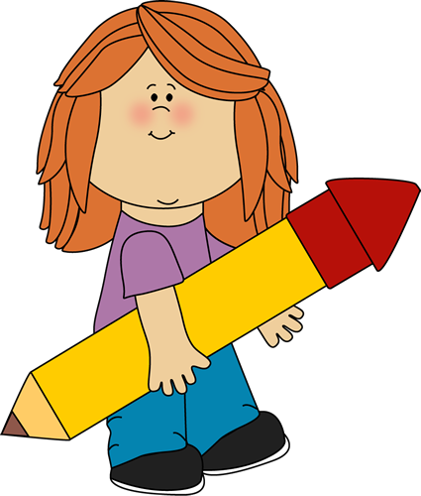
Editing Stations
Editing stations can be used during or after a written task. Instead of asking pupils to go through their whole piece of work and check it- which is often unsuccessful- they focus on one particular area to edit, meaning there is a much bigger impact on their writing.

Slide 2
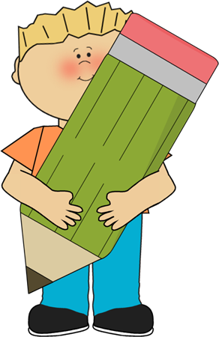
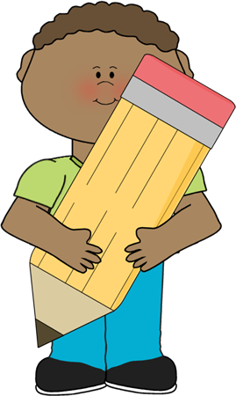
Capital Letters and Full Stops
Capital Letters
Capital letters for:
Proper nouns: Names (Steven), Places (London), Organisations (Nutella)
Beginning of sentences: The cat sat on the mat.
Full Stops
Full stops show the end of a sentence. A sentence should make sense, contain a subject and a verb. It must have a clear, independent meaning.

Slide 3
Spellings
Look through your work and pick out words you are not confident you have spelled correctly.
Use a dictionary to find the words and replace them with the correct spelling.

Slide 4
Vocabulary
Read through your writing and think carefully about the words you have chosen. Could you have used a word which would have a better effect?
Use a thesaurus to check for synonyms which would improve your writing.

Slide 5
Clauses and Phrases
A clause contains a subject and a verb:
Tara ate an apple after she had done her homework.
A phrase is a group of words which have meaning but no subject and verb: The big dog
Look at the positioning of the phrases and clauses within your sentences. Are they all in the same place? Would changing them improve your writing?
For example:
She was out of breath as she ran through the forest.
As she rang through the forest, she became out of breath.
Running through the forest, she became out of breath.
Out of breath, she ran through the forest.

Slide 6
Punctuation
Use your resources to help you spot where you have made mistakes with your punctuation.
Full stops and capital letters.
Commas (make sure you haven’t comma spliced- joining to independent clauses with a comma).
Question marks for questions.
Exclamation marks.
Semi Colons
Colons
Hyphens
Dashes
Brackets
Read your writing aloud. This will help you spot mistakes.

Slide 7
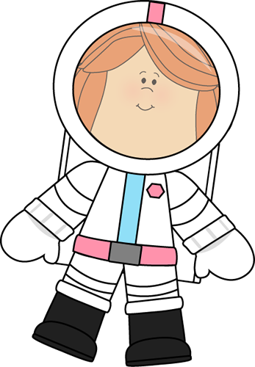
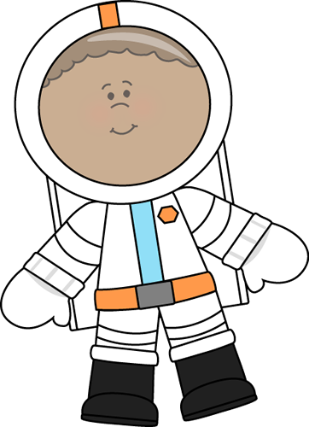
Figurative language
Descriptive writing can be brought to life with the use of figurative language.
Metaphor
The curtain shut on the events of the day and all was still in the land.
Simile
Like a lion hunting its prey, the waves crashed to the shore with tremendous force.
Personification
The trees whispered to each other and the leaves danced in the wind.

Slide 8
;
;
;
;
Semi-Colons
A semi colon links two main clauses which a closely linked. A comma cannot link them, and a full stop is too strong. The clauses link together where a conjunction might have been used:
The railway line runs through the town; the river runs alongside it.
Semi colons can also be used in a list where the items themselves contain commas:
In the meeting we have Daniel Wilson, University of Barnsley; Tajah Watson, Furness; Chris Custard, London and Mrs Syrup, New Zealand.

Slide 9
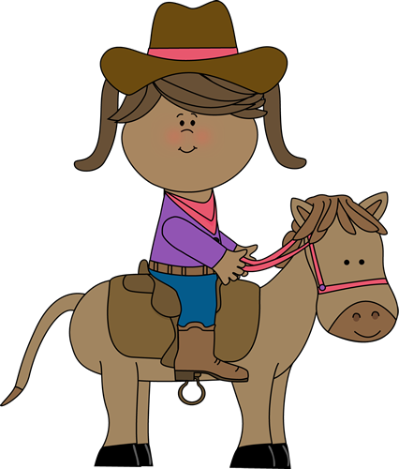
:
:
:
:
Colons
To introduce an idea
The glue won’t stick straight away: press on firmly.
To introduce a list
To make a sandwich, you will need: bread, ham and butter.
To introduce quoted material
My favourite quote from Shakespeare is: ‘To be or not to be, that is the question.’

Slide 10
Parenthesis
A parenthesis is an extra piece of information which is added to a sentence, which would still make sense without it.
Jack, who has brown hair, loves football.
Jack loves football.
Parenthesis can be inserted using commas, dashes or brackets.
Jack, who has brown hair, loves football.
Jack (who has brown hair) loves football.
Jack -who has brown hair- loves football.

Slide 11
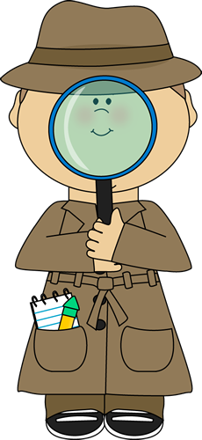
Speech
Have a look at the speech you have used in your writing. Is it accurate? Have you used too much or too little? Does to allow your writing to move forward?
Make sure you have used consistent speech marks. Either “” or ‘’.
Make sure your punctuation is inside your speech marks.
“Get back here now!”
Make sure you show who is speaking.
“Get out of here!” Julian exclaimed,
Julian exclaimed, “Get out of here!”

Slide 12
Read Out Loud
Reading out loud can help you to see where you have made mistakes, especially with missing words and tenses.
Read your writing to a partner and see if they can pick out mistakes.
Give your partner feedback on what you think of their writing. Remember to be constructive.

Slide 13
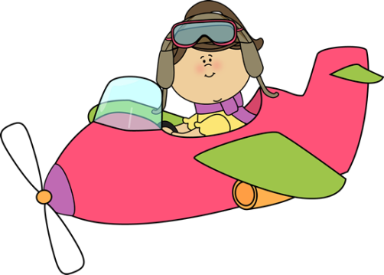
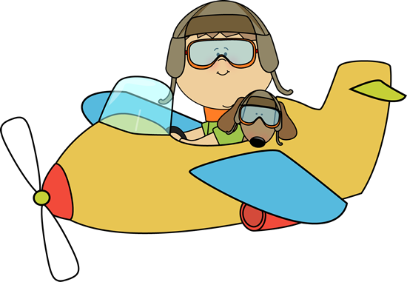
Finishing Time
You’ve been around all of the stations and you’ve done some excellent editing to improve your writing!
Now it’s time to sit, read and reflect on the edits you’ve made. Are there any other changes you think you could do to improve your writing even further?

Slide 14
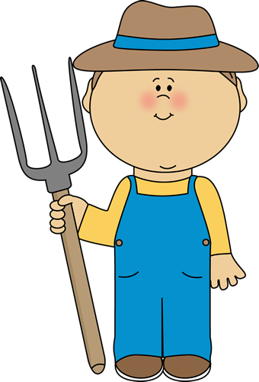
Targets
Have a look at your writing targets.
Have you met them in this piece of writing?
Is there something you can change so that you can meet your writing targets?
What would you give yourself as new targets for this piece of writing?

Slide 15
Openers
Start with a verb.
Running through the dense forest, Milly gasped for breath.
Start with an adverb
Quietly and quickly, Jennifer tiptoed towards the exit.
Make sure you vary the openers you use.
Start with a simile.
Like a roaring lion, the waves crashed loudly on the shore.
Start with a conjunction
Meanwhile, she fell asleep under the warmth of the sun.

Slide 16
Genius Time
Ask the Expert!
Here’s your chance to sit down with your teacher and get some individual feedback and support with your writing. Make sure you use your time wisely!

