Slide 1
Year 5/6 – Autumn Block 3 – Multiplication and Division – Step 2
About This Resource:
This PowerPoint has been designed to support your teaching of this small step from the Mixed Age planning. It includes a starter activity suitable for each year group and an example of each question from the Varied Fluency and Reasoning and Problem Solving resources also provided in this pack (separate for each year group). Each slide has the year group identified in the bottom right-hand corner. We recommend that you look through this PowerPoint in advance and decide whether to work through all examples provided or a selection of them depending on the needs of your class.
National Curriculum Objectives:
Mathematics Year 5: (5C6b) Multiply and divide whole numbers and those involving decimals by 10, 100 and 1,000
Mathematics Year 6: (6C6) Perform mental calculations, including with mixed operations and large numbers
More resources which follow the same small steps as White Rose.
Did you like this resource? Don’t forget to review it on our website.
© Classroom Secrets Limited 2018

Slide 2
Year 5/6 – Autumn Block 3 – Multiplication and Division
Step 2
Year 5: Multiplying by 10, 100 and 1,000
Year 6: Mental Calculations
© Classroom Secrets Limited 2018

Slide 3
Introduction
Complete the table below.
 | x 10 | x 100 | x 1,000
5 |  |  | 5,000
12 |  | 1,200
345 | 3,450
Y5
© Classroom Secrets Limited 2018

Slide 4
Introduction
Complete the table below.
 | x 10 | x 100 | x 1,000
5 | 50 | 500 | 5,000
12 | 120 | 1,200 | 12,000
345 | 3,450 | 34,500 | 345,000
Y5
© Classroom Secrets Limited 2018

Slide 5
Introduction
Answer these questions using mental calculations.
Calculate the difference between 180 and 820.
Double 750.
Multiply 40 x 30.
How many minutes are in three and a half hours?
The difference between a number and 35 is 15. What could the number be?
Y6
© Classroom Secrets Limited 2018

Slide 6
Introduction
Answer these questions using mental calculations.
Calculate the difference between 180 and 820.
Double 750.
Multiply 40 x 30.
How many minutes are in three and a half hours?
The difference between a number and 35 is 15. What could the number be?
640
1,500
1,200
210
20 or 50
Y6
© Classroom Secrets Limited 2018

Slide 7
Varied Fluency 1
Circle the correct answer to the following calculation.
972 x 100 =
9,270 |  | 9,720 |  | 97,200
Y5
© Classroom Secrets Limited 2018

Slide 8
Varied Fluency 1
Circle the correct answer to the following calculation.
972 x 100 =
9,270 |  | 9,720 |  | 97,200
Y5
© Classroom Secrets Limited 2018

Slide 9
Varied Fluency 2
Complete the calculation.
 | = | 3,684 | x | 10
Y5
© Classroom Secrets Limited 2018

Slide 10
Varied Fluency 2
Complete the calculation.
36,840 | = | 3,684 | x | 10
Y5
© Classroom Secrets Limited 2018

Slide 11
Varied Fluency 3
Work out the number shown below.
Multiply the number by 10.
Draw where the counters will be now.
Th | H | T | O
Th | H | T | O
Y5
© Classroom Secrets Limited 2018

Slide 12
Varied Fluency 3
Work out the number shown below.
121
Multiply the number by 10.
Draw where the counters will be now.
1,210
Th | H | T | O
Th | H | T | O
Y5
© Classroom Secrets Limited 2018

Slide 13
Varied Fluency 4
Complete the calculation.
512 | x |  | = | 51,200
Y5
© Classroom Secrets Limited 2018

Slide 14
Varied Fluency 4
Complete the calculation.
512 | x | 100 | = | 51,200
Y5
© Classroom Secrets Limited 2018

Slide 15
Varied Fluency 1
Use this fact to calculate the following:
260 x 52 =
2.6 x 520 =
260 x 520 =
2,600 x 52 =
26 x 5,200 =
26 x 52 = 1,352
Y6
© Classroom Secrets Limited 2018

Slide 16
Varied Fluency 1
Use this fact to calculate the following:
260 x 52 = 13,520
2.6 x 520 = 1,352
260 x 520 = 135,200
2,600 x 52 = 135,200
26 x 5,200 = 135,200
26 x 52 = 1,352
Y6
© Classroom Secrets Limited 2018

Slide 17
Varied Fluency 2
Use mental calculations to find the odd one out.
1
4
550 – 300
of 1,000
2,500 ÷ 10
1
2
of 5,000
25 x 10
Y6
© Classroom Secrets Limited 2018

Slide 18
Varied Fluency 2
Use mental calculations to find the odd one out.
1
4
550 – 300
= 250
of 1,000
= 250
2,500 ÷ 10
= 250
1
2
of 5,000
= 2,500
25 x 10
= 250
Y6
© Classroom Secrets Limited 2018

Slide 19
Varied Fluency 3
Match the question to the correct answer.
25 x 120 =
400
110 x 12 =
3,000
3,200 ÷ 8 =
1,320
Y6
© Classroom Secrets Limited 2018

Slide 20
Varied Fluency 3
Match the question to the correct answer.
25 x 120 =
400
110 x 12 =
3,000
3,200 ÷ 8 =
1,320
Y6
© Classroom Secrets Limited 2018

Slide 21
Varied Fluency 4
Find the missing number.
17 x x 10 = 3,400
Y6
© Classroom Secrets Limited 2018

Slide 22
Varied Fluency 4
Find the missing number.
17 x 20 x 10 = 3,400
Y6
© Classroom Secrets Limited 2018

Slide 23
Problem Solving 1
Soffia has 83 pencils.
Jacob has 10 times as many pencils as Soffia.
Kye has 10 times as many pencils as Jacob.
How many do they have altogether?
Y5
© Classroom Secrets Limited 2018

Slide 24
Problem Solving 1
Soffia has 83 pencils.
Jacob has 10 times as many pencils as Soffia.
Kye has 10 times as many pencils as Jacob.
How many do they have altogether?
83 + 830 + 8,300 = 9,213
Y5
© Classroom Secrets Limited 2018

Slide 25
Reasoning 1
Nigel bounces a ball 2,478 times.
Amira bounces a ball 24,748 times.
Amira says,
Is Amira correct? Explain your answer.
I have bounced the ball 10 times as many times as you.
Y5
© Classroom Secrets Limited 2018

Slide 26
Reasoning 1
Nigel bounces a ball 2,478 times.
Amira bounces a ball 24,748 times.
Amira says,
Is Amira correct? Explain your answer.
Amira is incorrect because…
I have bounced the ball 10 times as many times as you.
Y5
© Classroom Secrets Limited 2018

Slide 27
Reasoning 1
Nigel bounces a ball 2,478 times.
Amira bounces a ball 24,748 times.
Amira says,
Is Amira correct? Explain your answer.
Amira is incorrect because 2,478 x 10 = 24,780.
I have bounced the ball 10 times as many times as you.
Y5
© Classroom Secrets Limited 2018

Slide 28
Reasoning 2
Which number is the odd one out? Convince me.
A. 945
B. 2,340
C. 94,500
D. 3,240
E. 23,400
Y5
© Classroom Secrets Limited 2018

Slide 29
Reasoning 2
Which number is the odd one out? Convince me.
D is the odd one out because…
A. 945
B. 2,340
C. 94,500
D. 3,240
E. 23,400
Y5
© Classroom Secrets Limited 2018

Slide 30
Reasoning 2
Which number is the odd one out? Convince me.
D is the odd one out because 945 x 100 = 94,500 and 2,340 x 10 = 23,400.
A. 945
B. 2,340
C. 94,500
D. 3,240
E. 23,400
Y5
© Classroom Secrets Limited 2018

Slide 31
Problem Solving 1
Give 3 different ways of calculating the following mentally:
252 x 9
Y6
© Classroom Secrets Limited 2018

Slide 32
Problem Solving 1
Give 3 different ways of calculating the following mentally:
Various answers, for example:
(252 x 10) – (252 x 1)
(200 x 9) + (50 x 9) + (2 x 9)
252 x 2 x 2 x 2 + 252
252 x 9
Y6
© Classroom Secrets Limited 2018

Slide 33
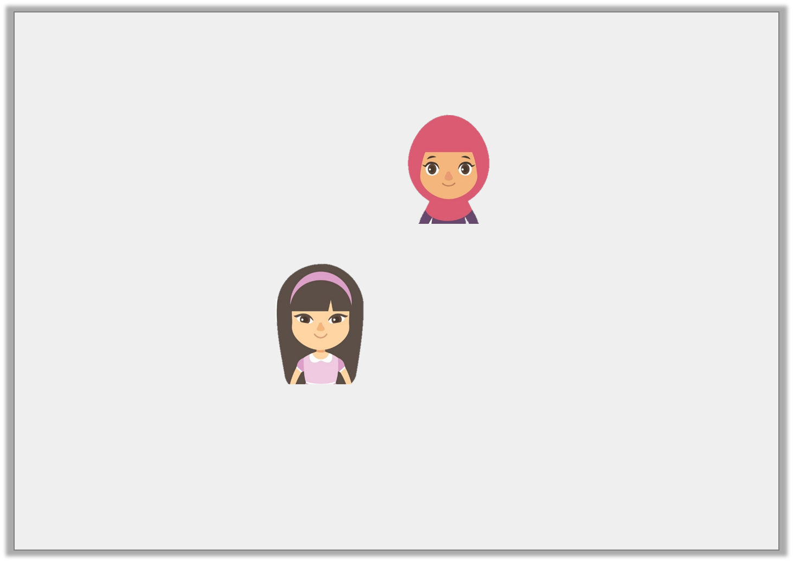
Reasoning 1
Hafsah and Lucy are solving the calculation 223 x 2 x 15.
Who is correct? Explain why.
I did 15 x 2 = 30, then 223 x 10 = 2,230, then x 3. My answer is 6,690.
Hafsah
I did 223 x 2 = 446, then I x by 10, then by 5. My answer is 22,300.
Lucy
Y6
© Classroom Secrets Limited 2018

Slide 34
Reasoning 1
Hafsah and Lucy are solving the calculation 223 x 2 x 15.
Who is correct? Explain why.
Hafsah is correct because…
Lucy is incorrect because…
I did 15 x 2 = 30, then 223 x 10 = 2,230, then x 3. My answer is 6,690.
Hafsah
I did 223 x 2 = 446, then I x by 10, then by 5. My answer is 22,300.
Lucy
Y6
© Classroom Secrets Limited 2018

Slide 35
Reasoning 1
Hafsah and Lucy are solving the calculation 223 x 2 x 15.
Who is correct? Explain why.
Hafsah is correct because she has split the calculation into parts to work out the answer.
Lucy is incorrect because she has multiplied by 50, not 15.
I did 15 x 2 = 30, then 223 x 10 = 2,230, then x 3. My answer is 6,690.
Hafsah
I did 223 x 2 = 446, then I x by 10, then by 5. My answer is 22,300.
Lucy
Y6
© Classroom Secrets Limited 2018

Slide 36
Reasoning 2
Kian is estimating the cost of 3 items.
Which calculation would give him the best estimation?
a. b.
Explain why.
T-shirt = £14.99; Jeans = £29.99; Jacket = £34.99
15 + 30 + 35
14 + 29 + 34
Y6
© Classroom Secrets Limited 2018

Slide 37
Reasoning 2
Kian is estimating the cost of 3 items.
Which calculation would give him the best estimation?
a. b.
Explain why.
Calculation a would give the best estimation because…
T-shirt = £14.99; Jeans = £29.99; Jacket = £34.99
15 + 30 + 35
14 + 29 + 34
Y6
© Classroom Secrets Limited 2018

Slide 38
Reasoning 2
Kian is estimating the cost of 3 items.
Which calculation would give him the best estimation?
a. b.
Explain why.
Calculation a would give the best estimation because the numbers have been correctly rounded up to the nearest £1 whereas calculation b has been incorrectly rounded down to the nearest £1.
T-shirt = £14.99; Jeans = £29.99; Jacket = £34.99
15 + 30 + 35
14 + 29 + 34
Y6
© Classroom Secrets Limited 2018

