Slide 1
LIFE/work balance
We have started a #LIFEworkbalance campaign and we need your help to complete our LIFE/work balance survey.
We hope to publish the results soon, so please give 15 minutes of your time to help us get a true picture of school life.
Want to be a part of this campaign? Take the survey on our website and share it with your colleagues!
© Classroom Secrets Limited 2019

Slide 2
Year 5/6 – Autumn Block 1 – Place Value – Step 9
About This Resource:
This PowerPoint has been designed to support your teaching of this small step from the Mixed Age planning. It includes a starter activity suitable for each year group and an example of each question from the Varied Fluency and Reasoning and Problem Solving resources also provided in this pack (separate for each year group). Each slide has the year group identified in the bottom right-hand corner. We recommend that you look through this PowerPoint in advance and decide whether to work through all examples provided or a selection of them depending on the needs of your class.
National Curriculum Objectives:
Mathematics Year 5: (5N2) Read, write, order and compare numbers to at least 1 000 000 and determine the value of each digit
Mathematics Year 5: (5N4) Round any number up to 1 000 000 to the nearest 10, 100, 1000, 10 000 and 100 000
Mathematics Year 5: (5N6) Solve number problems and practical problems that involve (5N1) (5N2) (5N4) (5N5)
More Year 5 and Year 6 Place Value resources.
Did you like this resource? Don’t forget to review it on our website.
© Classroom Secrets Limited 2018

Slide 3
Year 5/6 – Autumn Block 1 – Place Value
Step 9
Year 5: Round Within 100,000
© Classroom Secrets Limited 2018

Slide 4
Introduction
Which multiples of 1,000 do these numbers sit between?
Which multiples of 10,000 do these numbers sit between?
4,700
8,200
28,000
64,000
Y5
© Classroom Secrets Limited 2018

Slide 5
Introduction
Which multiples of 1,000 do these numbers sit between?
Which multiples of 10,000 do these numbers sit between?
4,000
4,700
5,000
8,000
8,200
9,000
20,000
28,000
30,000
60,000
64,000
70,000
Y5
© Classroom Secrets Limited 2018

Slide 6
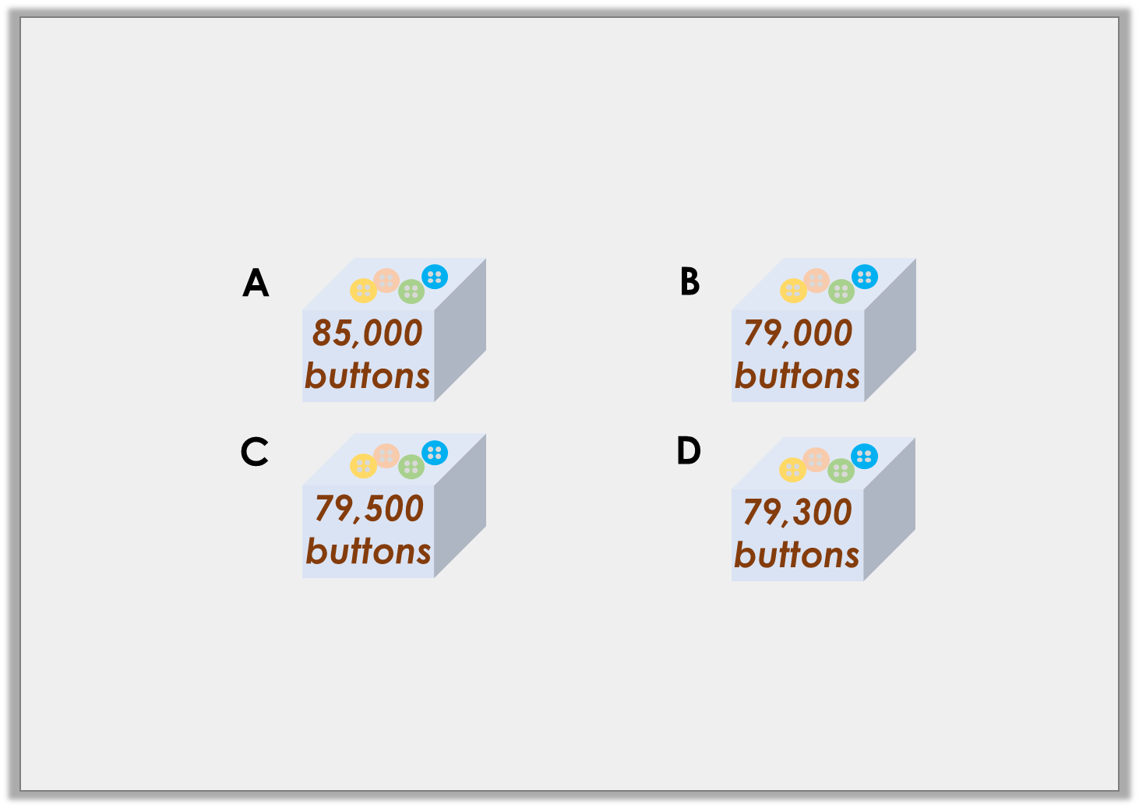
Varied Fluency 1
A factory needs 79,360 buttons.
Which box should they order?
Y5
© Classroom Secrets Limited 2018

Slide 7
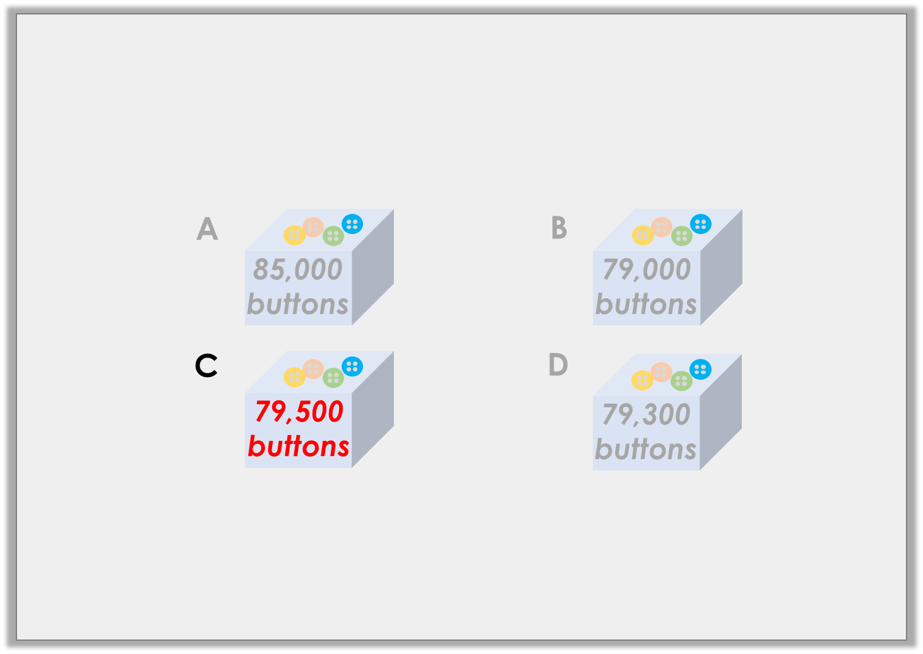
Varied Fluency 1
A factory needs 79,360 buttons.
Which box should they order?
Y5
© Classroom Secrets Limited 2018

Slide 8
Varied Fluency 2
Round the number of followers of each platform to the nearest thousand.
Platform | Followers
ChatterIt | Seventy-two thousand and fifty-nine
MyBook | 69,109
InPhoto | 41,804
Y5
© Classroom Secrets Limited 2018

Slide 9
Varied Fluency 2
Round the number of followers of each platform to the nearest thousand.
ChatterIt - 72,000
MyBook - 69,000
InPhoto - 42,000
Platform | Followers
ChatterIt | Seventy-two thousand and fifty-nine
MyBook | 69,109
InPhoto | 41,804
Y5
© Classroom Secrets Limited 2018

Slide 10
Varied Fluency 3
Round each number to the nearest 10,000.
10,959
twenty-one thousand and nine
39,091
99,961
Y5
© Classroom Secrets Limited 2018

Slide 11
Varied Fluency 3
Round each number to the nearest 10,000.
10,000; 20,000; 40,000; 100,000
10,959
twenty-one thousand and nine
39,091
99,961
Y5
© Classroom Secrets Limited 2018

Slide 12
Varied Fluency 4
Complete the diagram.
nearest 10
Ninety-two thousand and eighty-three
nearest 100
nearest 1,000
Y5
© Classroom Secrets Limited 2018

Slide 13
Varied Fluency 4
Complete the diagram.
nearest 10
92,080
Ninety-two thousand and eighty-three
nearest 100
92,100
nearest 1,000
92,000
Y5
© Classroom Secrets Limited 2018

Slide 14
Problem Solving 1
Using all 5 digit cards, write down all the numbers you can create which round to 28,000 when rounded to the nearest thousand.
4
two
8
3
one
Y5
© Classroom Secrets Limited 2018

Slide 15
Problem Solving 1
Using all 5 digit cards, write down all the numbers you can create which round to 28,000 when rounded to the nearest thousand.
28,134; 28,143; 28,314; 28,341; 28,413; 28,431
4
two
8
3
one
Y5
© Classroom Secrets Limited 2018

Slide 16
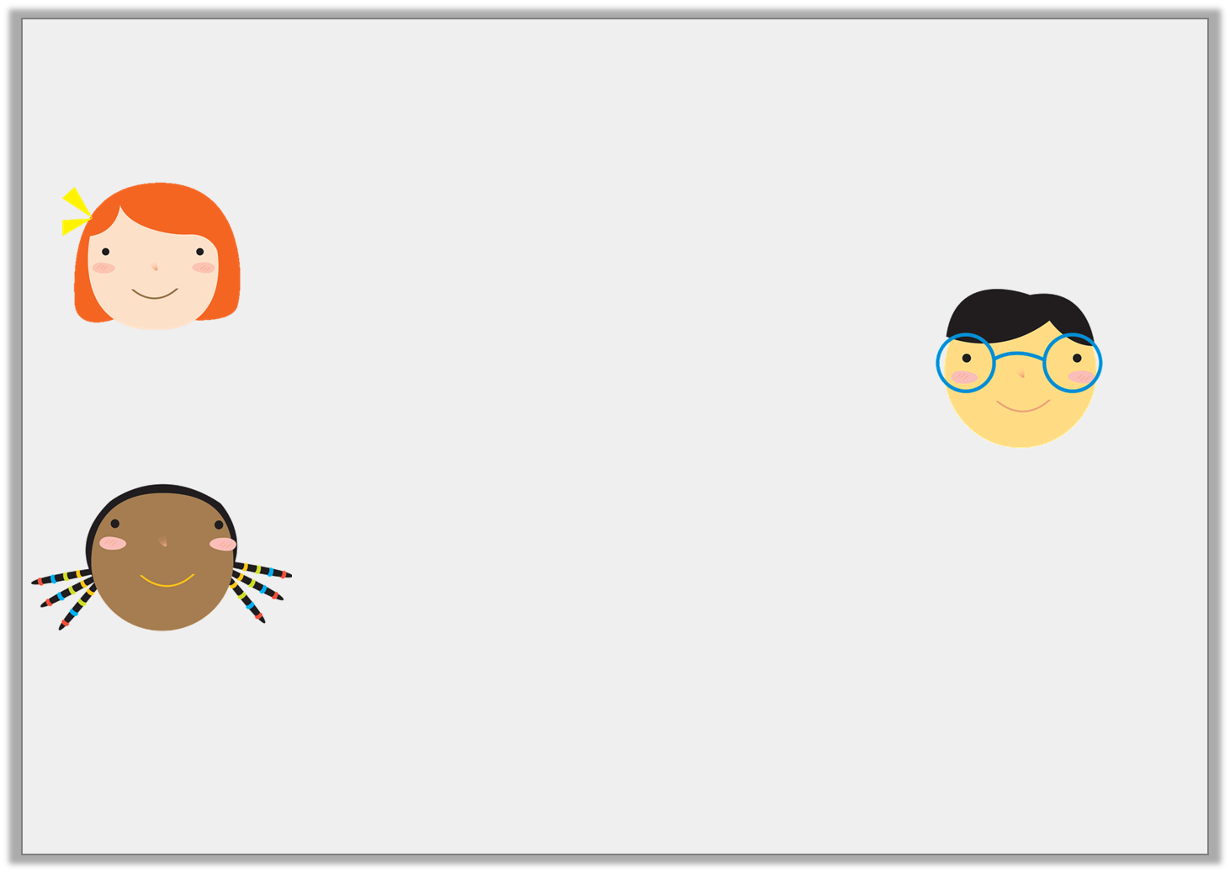
Reasoning 1
The children are rounding the number 32,186 to the nearest 10.
Who is correct? Explain your answer.
The answer is 32,190.
Mhairi
It’s definitely thirty-two thousand.
I know it’s 31,190.
Bolin
Joely
Y5
© Classroom Secrets Limited 2018

Slide 17
Reasoning 1
The children are rounding the number 32,186 to the nearest 10.
Who is correct? Explain your answer.
Mhairi is correct because…
The answer is 32,190.
Mhairi
It’s definitely thirty-two thousand.
I know it’s 31,190.
Bolin
Joely
Y5
© Classroom Secrets Limited 2018

Slide 18
Reasoning 1
The children are rounding the number 32,186 to the nearest 10.
Who is correct? Explain your answer.
Mhairi is correct because 32,186 rounded to the nearest ten is 32,190. Bolin has rounded the number to the nearest thousand, and Joely has subtracted 1,000 instead.
The answer is 32,190.
Mhairi
It’s definitely thirty-two thousand.
I know it’s 31,190.
Bolin
Joely
Y5
© Classroom Secrets Limited 2018

Slide 19
Reasoning 2
Which is the odd one out?
Explain your choice.
16,872
23,802
15,919
fourteen thousand, nine hundred
Y5
© Classroom Secrets Limited 2018

Slide 20
Reasoning 2
Which is the odd one out?
Explain your choice.
14,900 is the odd one out because…
16,872
23,802
15,919
fourteen thousand, nine hundred
Y5
© Classroom Secrets Limited 2018

Slide 21
Reasoning 2
Which is the odd one out?
Explain your choice.
14,900 is the odd one out because 14,900 rounds to 10,000 when rounding to the nearest ten thousand. The others round to 20,000.
16,872
23,802
15,919
fourteen thousand, nine hundred
Y5
© Classroom Secrets Limited 2018

